Slide 1

WINTER SCHOOL

Slide 2

Fundamentals of
Automatic Speech Recognition
Part 1: Basic Mathematics of ASR (45 min)
Part 2: Neural Models for ASR (60 min)
Part 3: Speech Representation Learning (30 min)
Sanjeev Khudanpur and Matthew Wiesner @ Johns Hopkins University, 8 December 2024

Slide 3

The Basic Mathematics of
Automatic Speech Recognition
The Source-Channel Model
Hidden Markov Models
N-gram Models
Viterbi Search

Slide 4
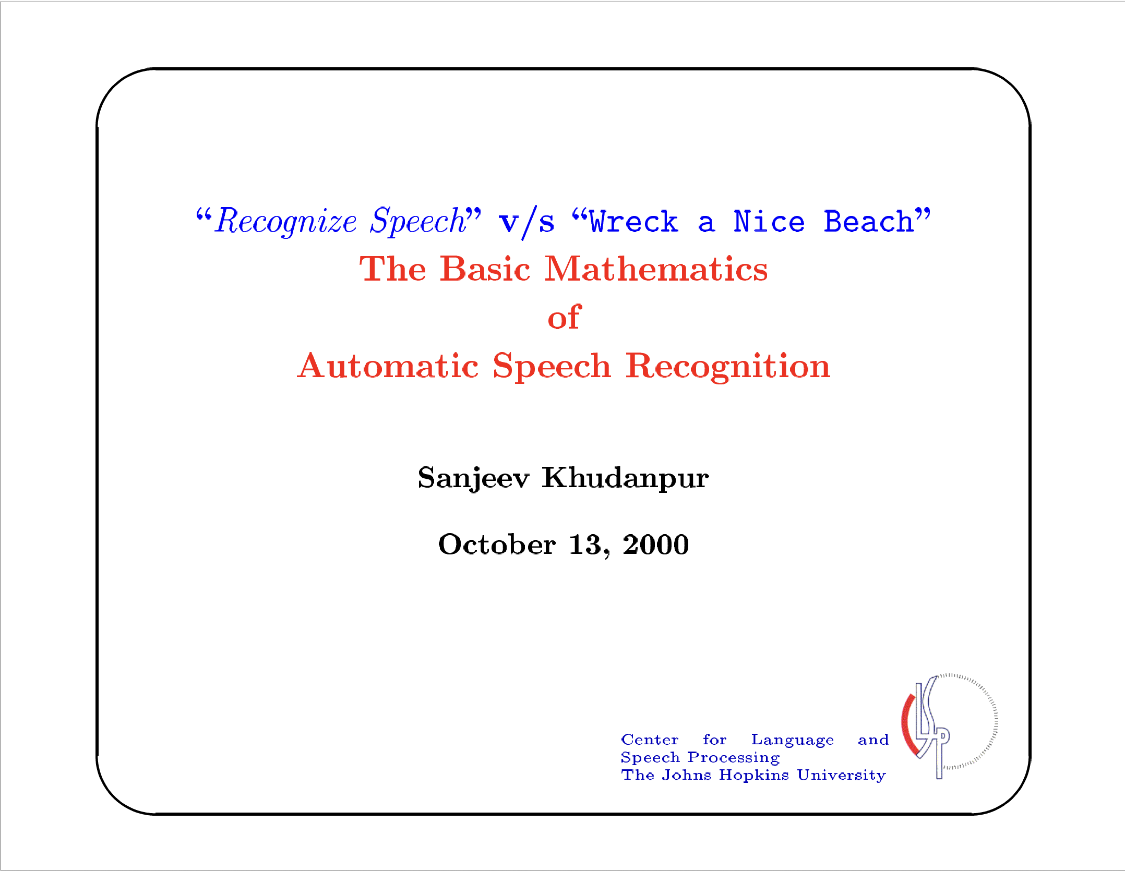

Slide 5
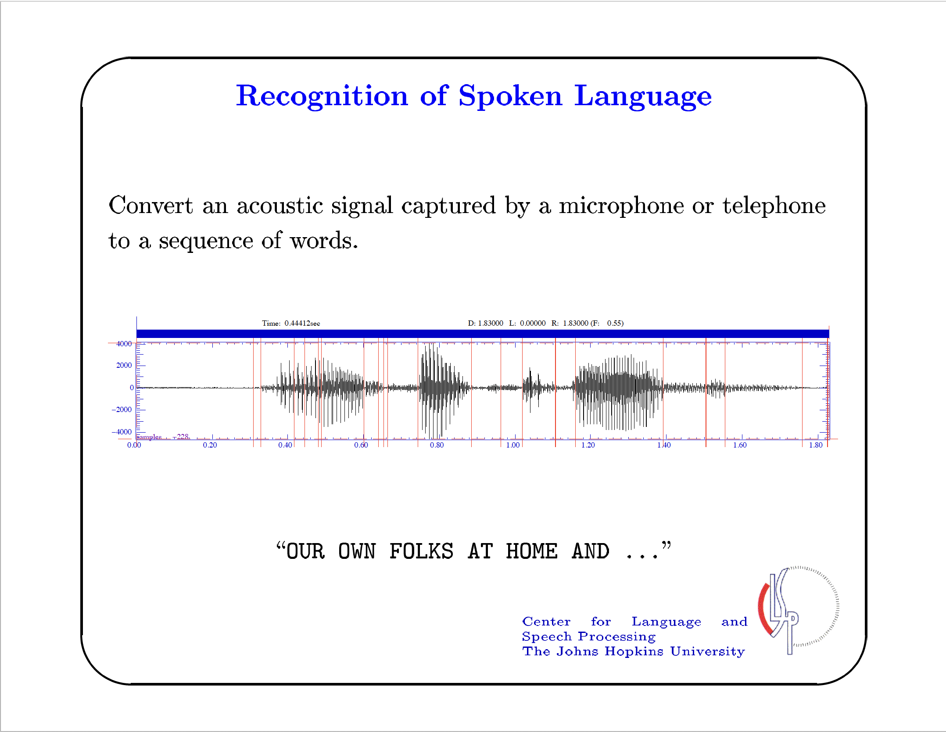

Slide 6
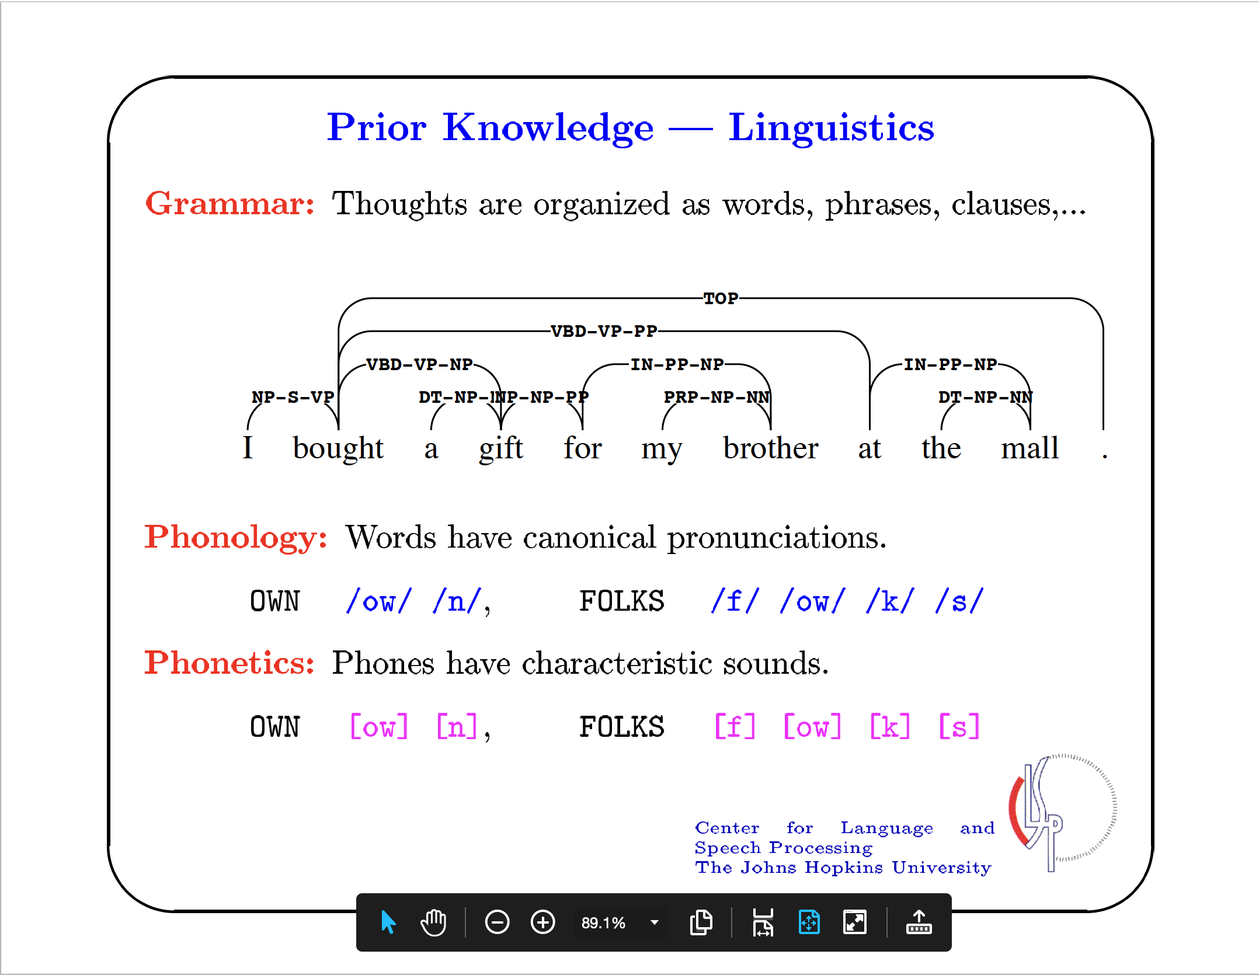

Slide 7
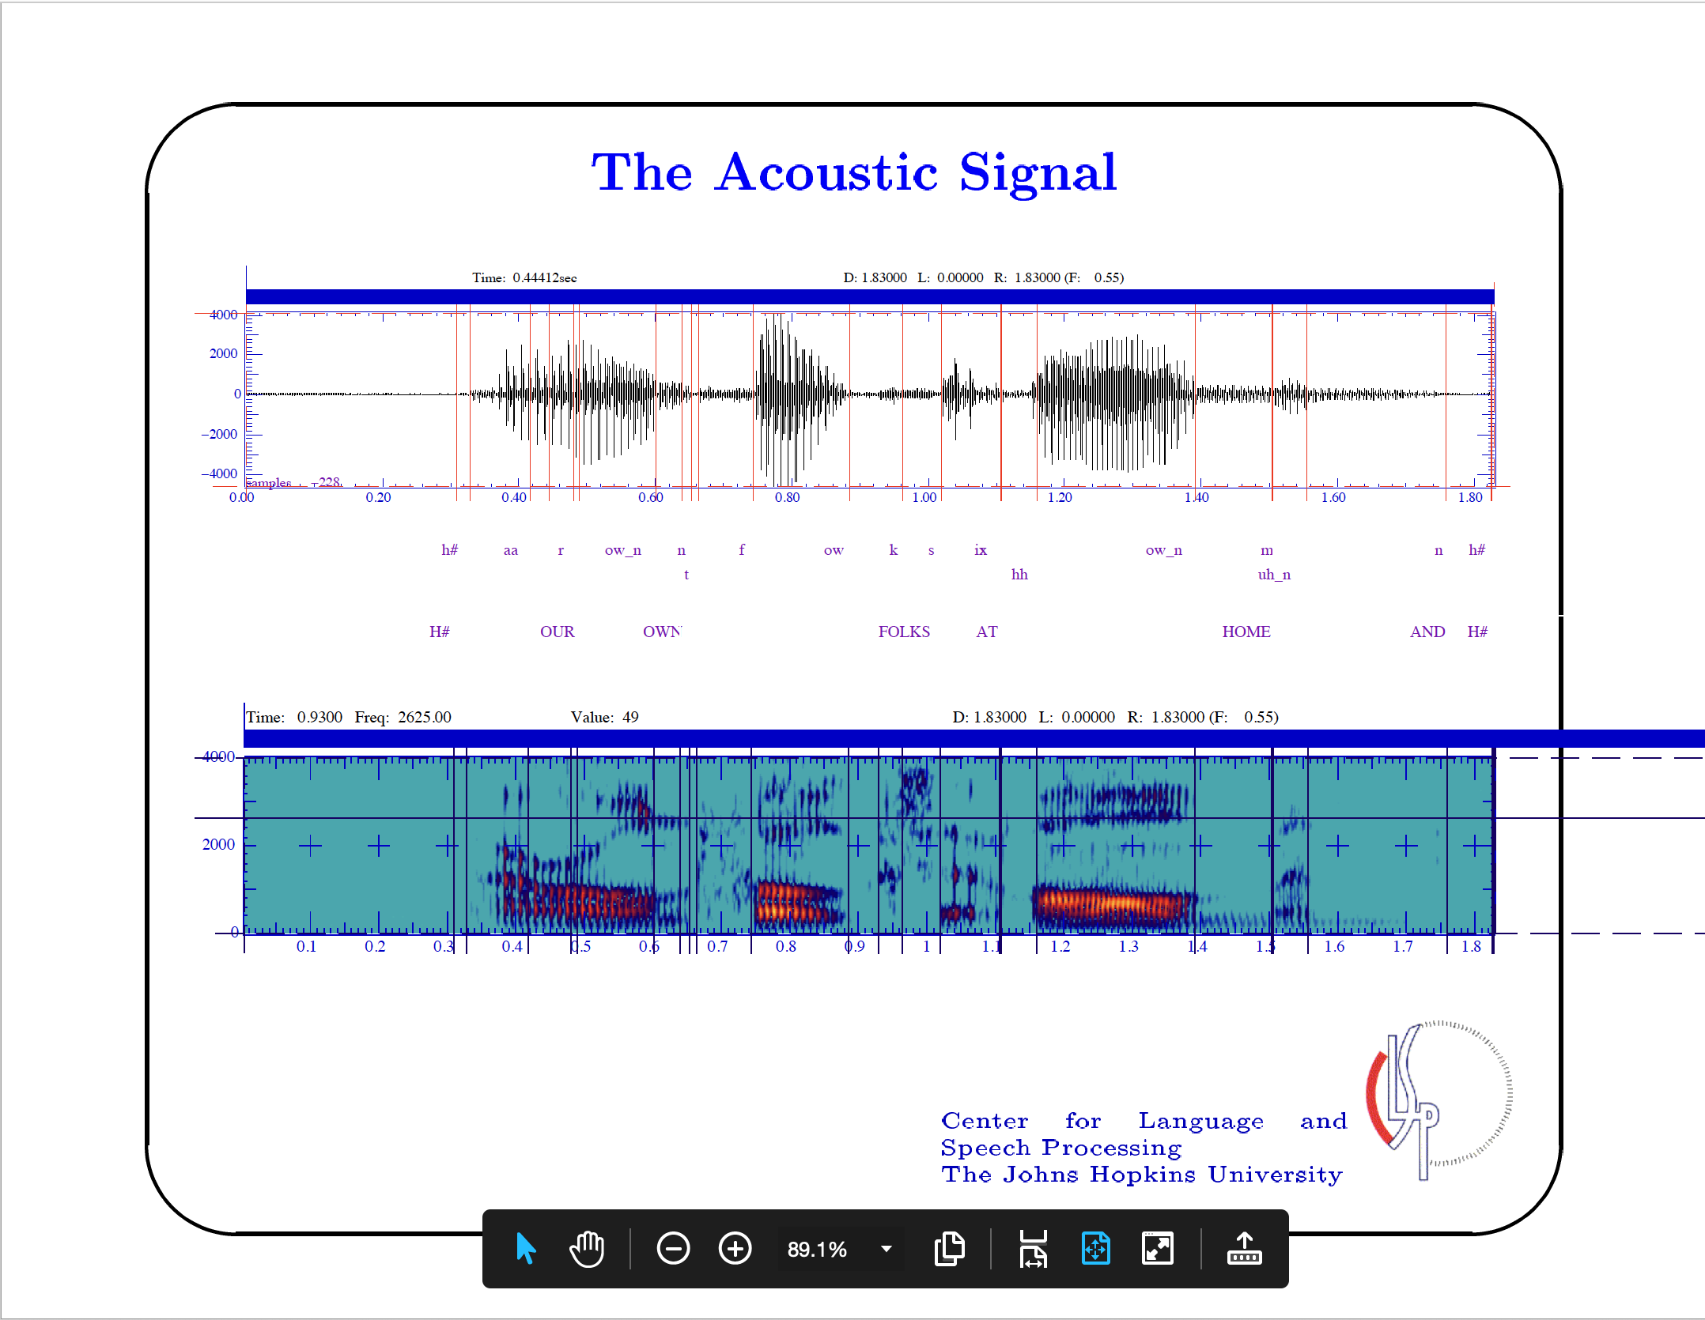

Slide 8
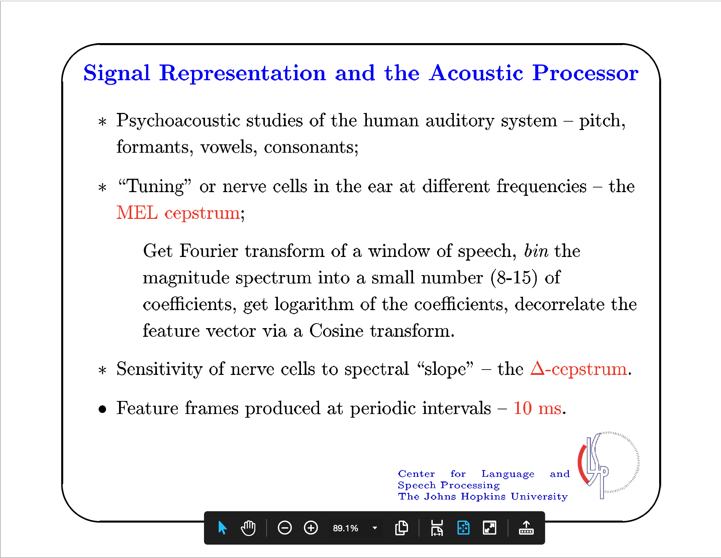

Slide 9
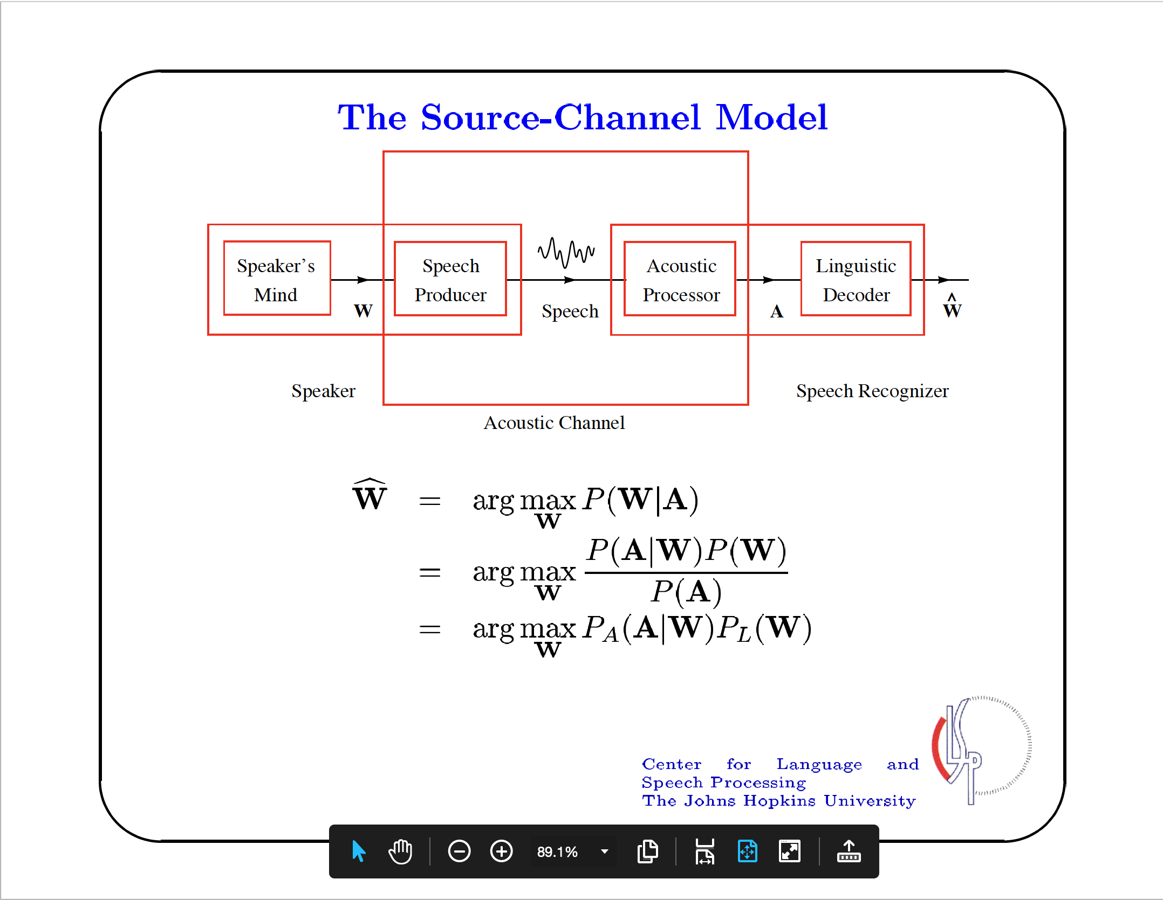

Slide 10
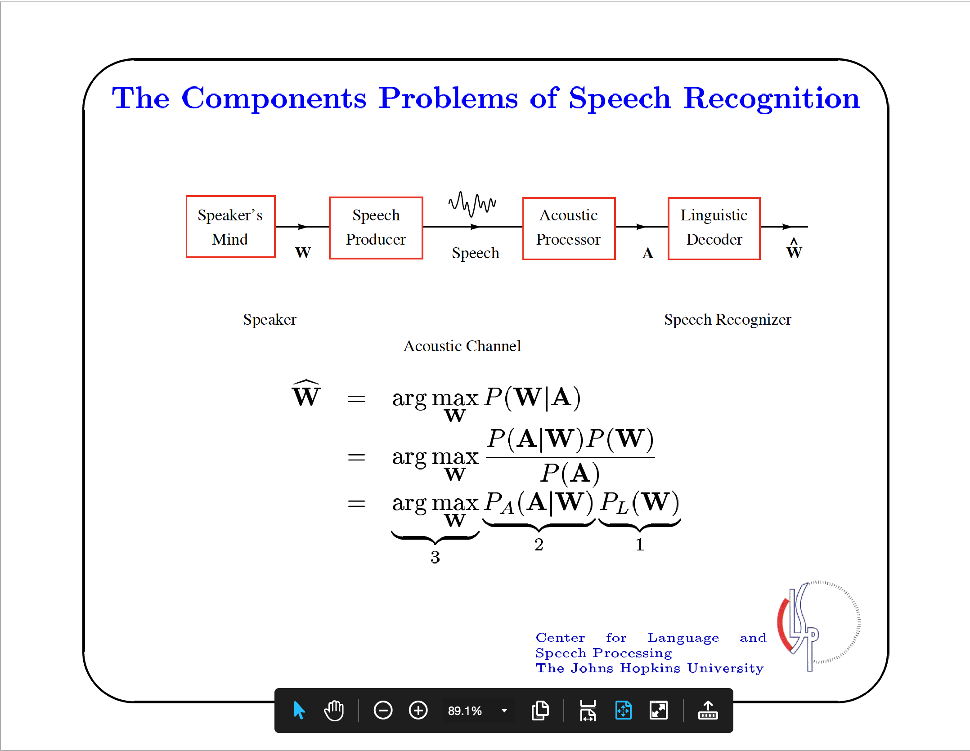

Slide 11
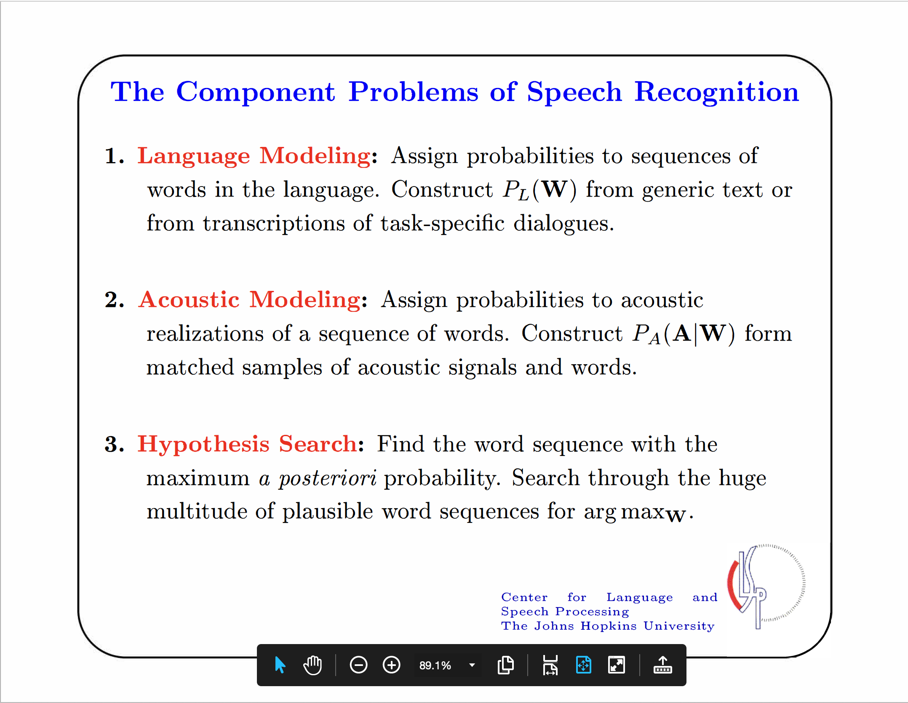

Slide 12
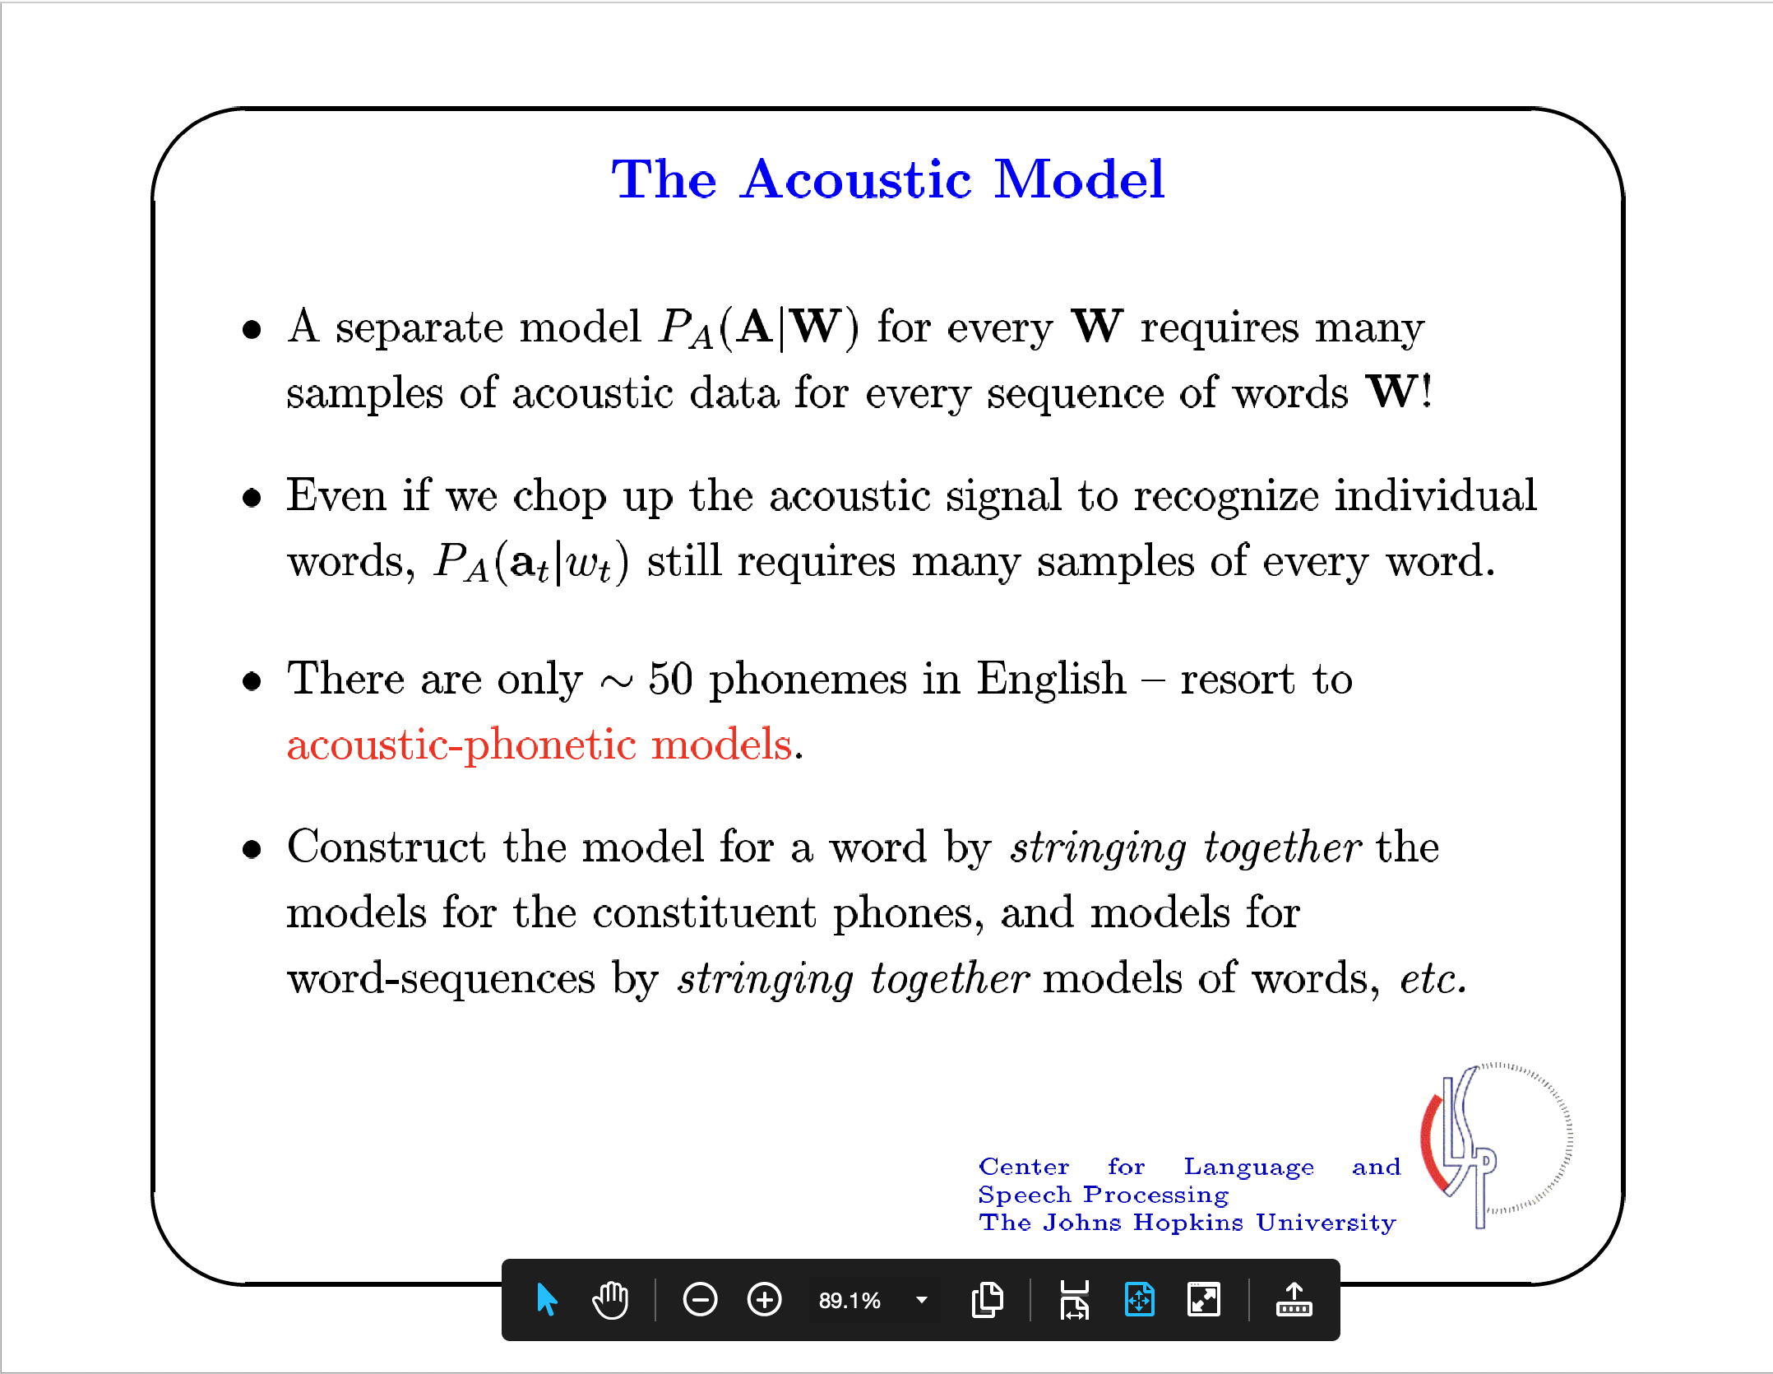

Slide 13
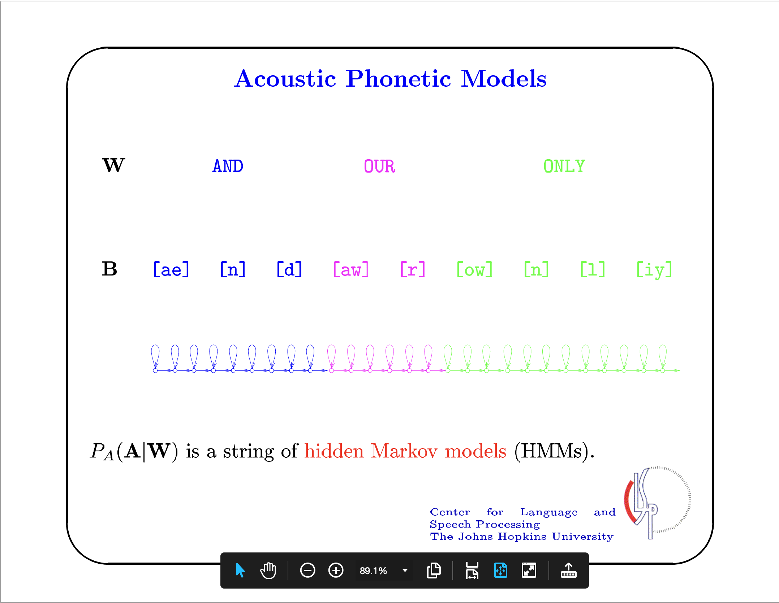

Slide 14
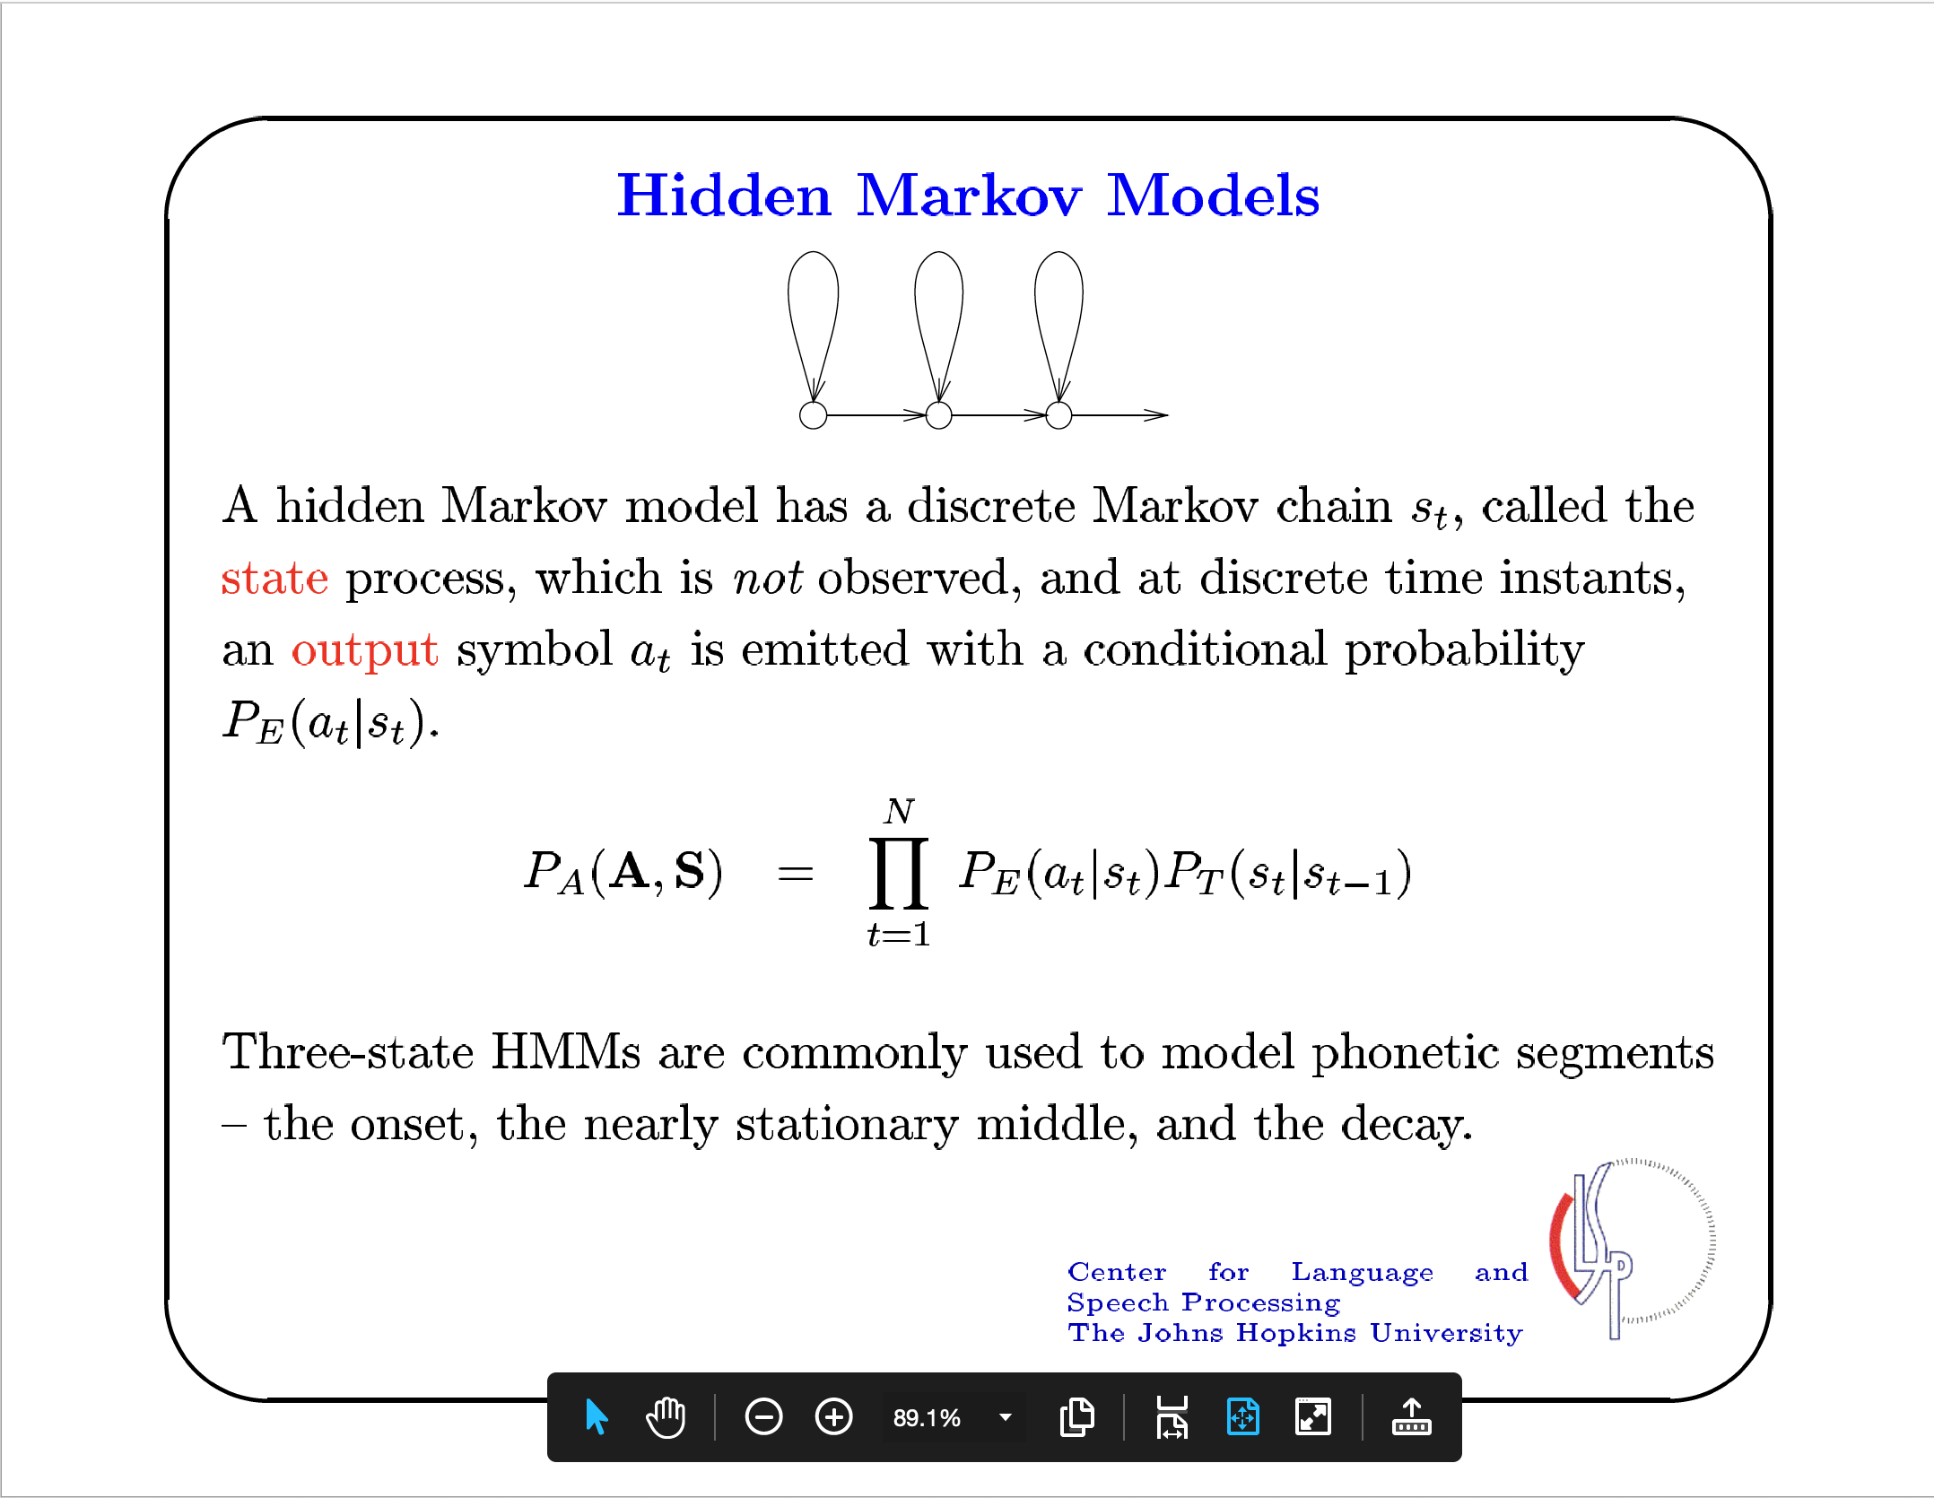

Slide 15
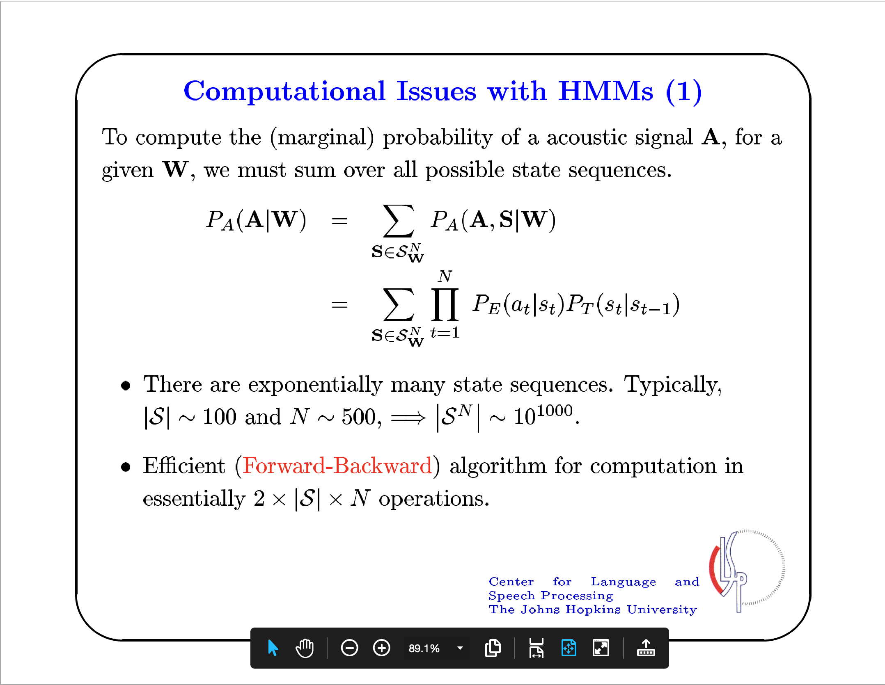

Slide 16
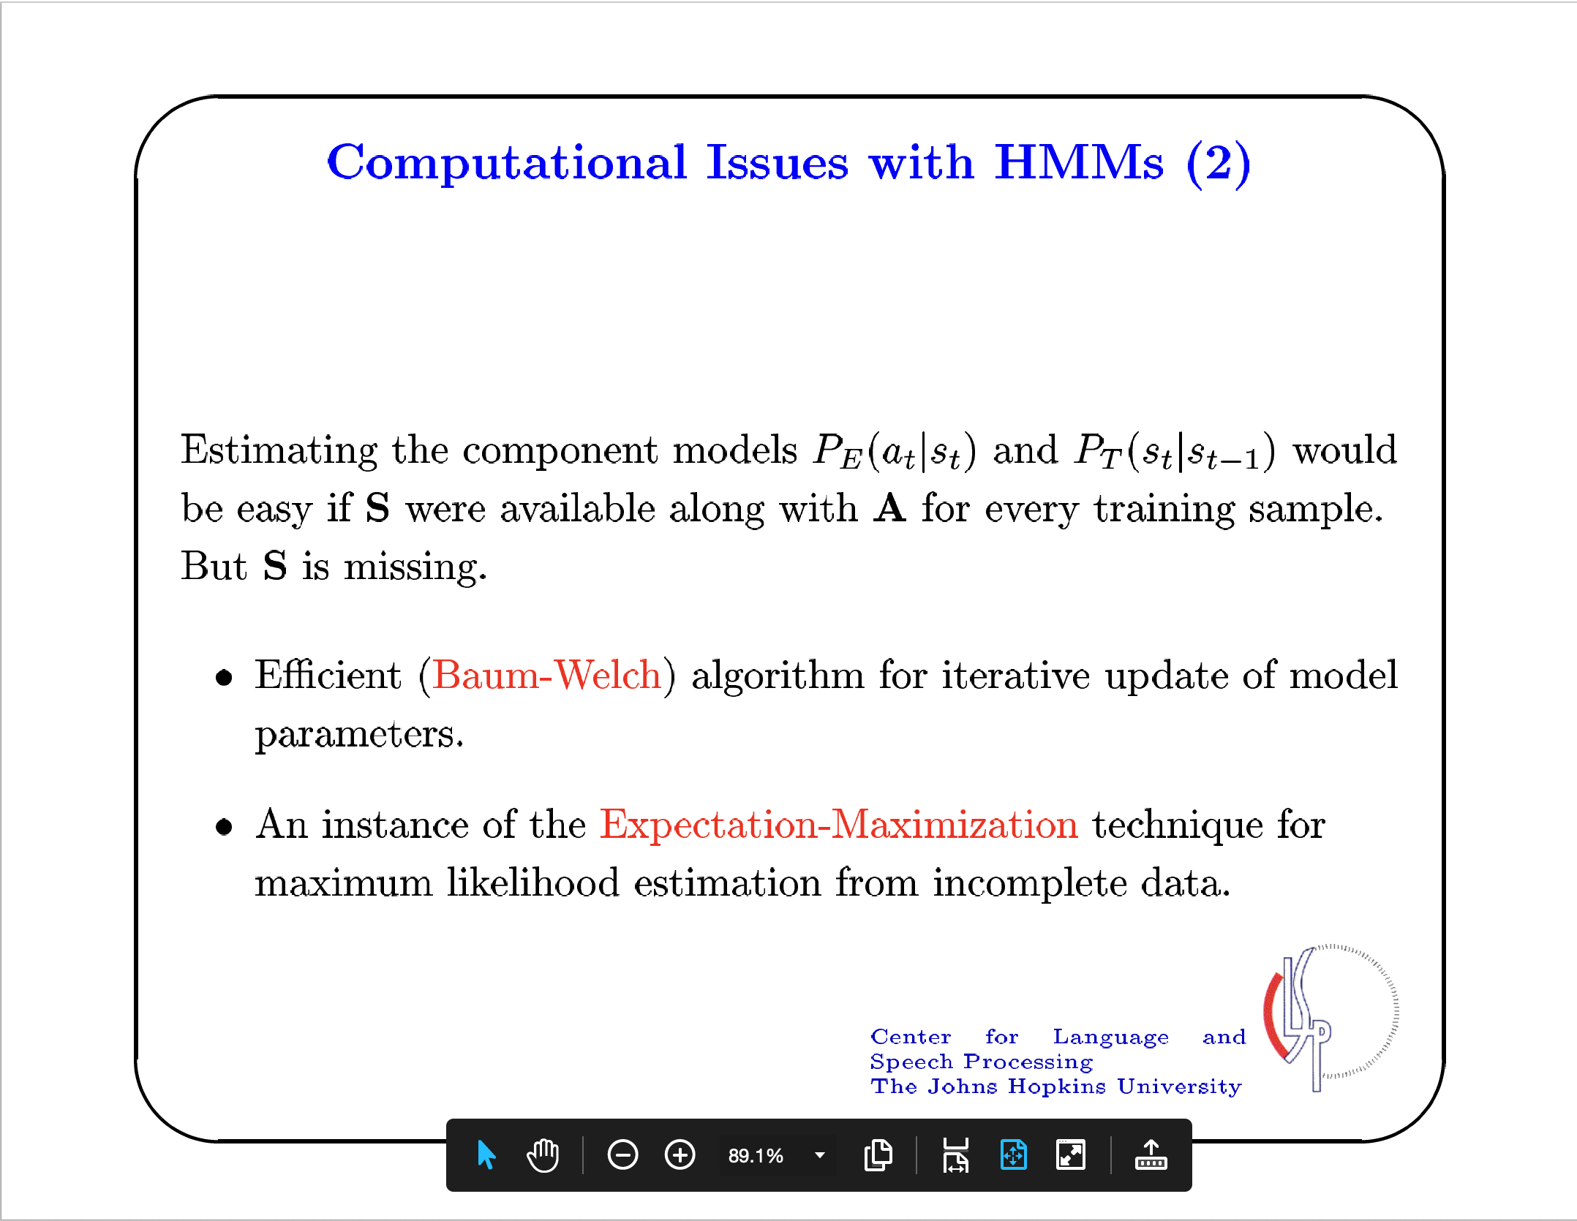

Slide 17
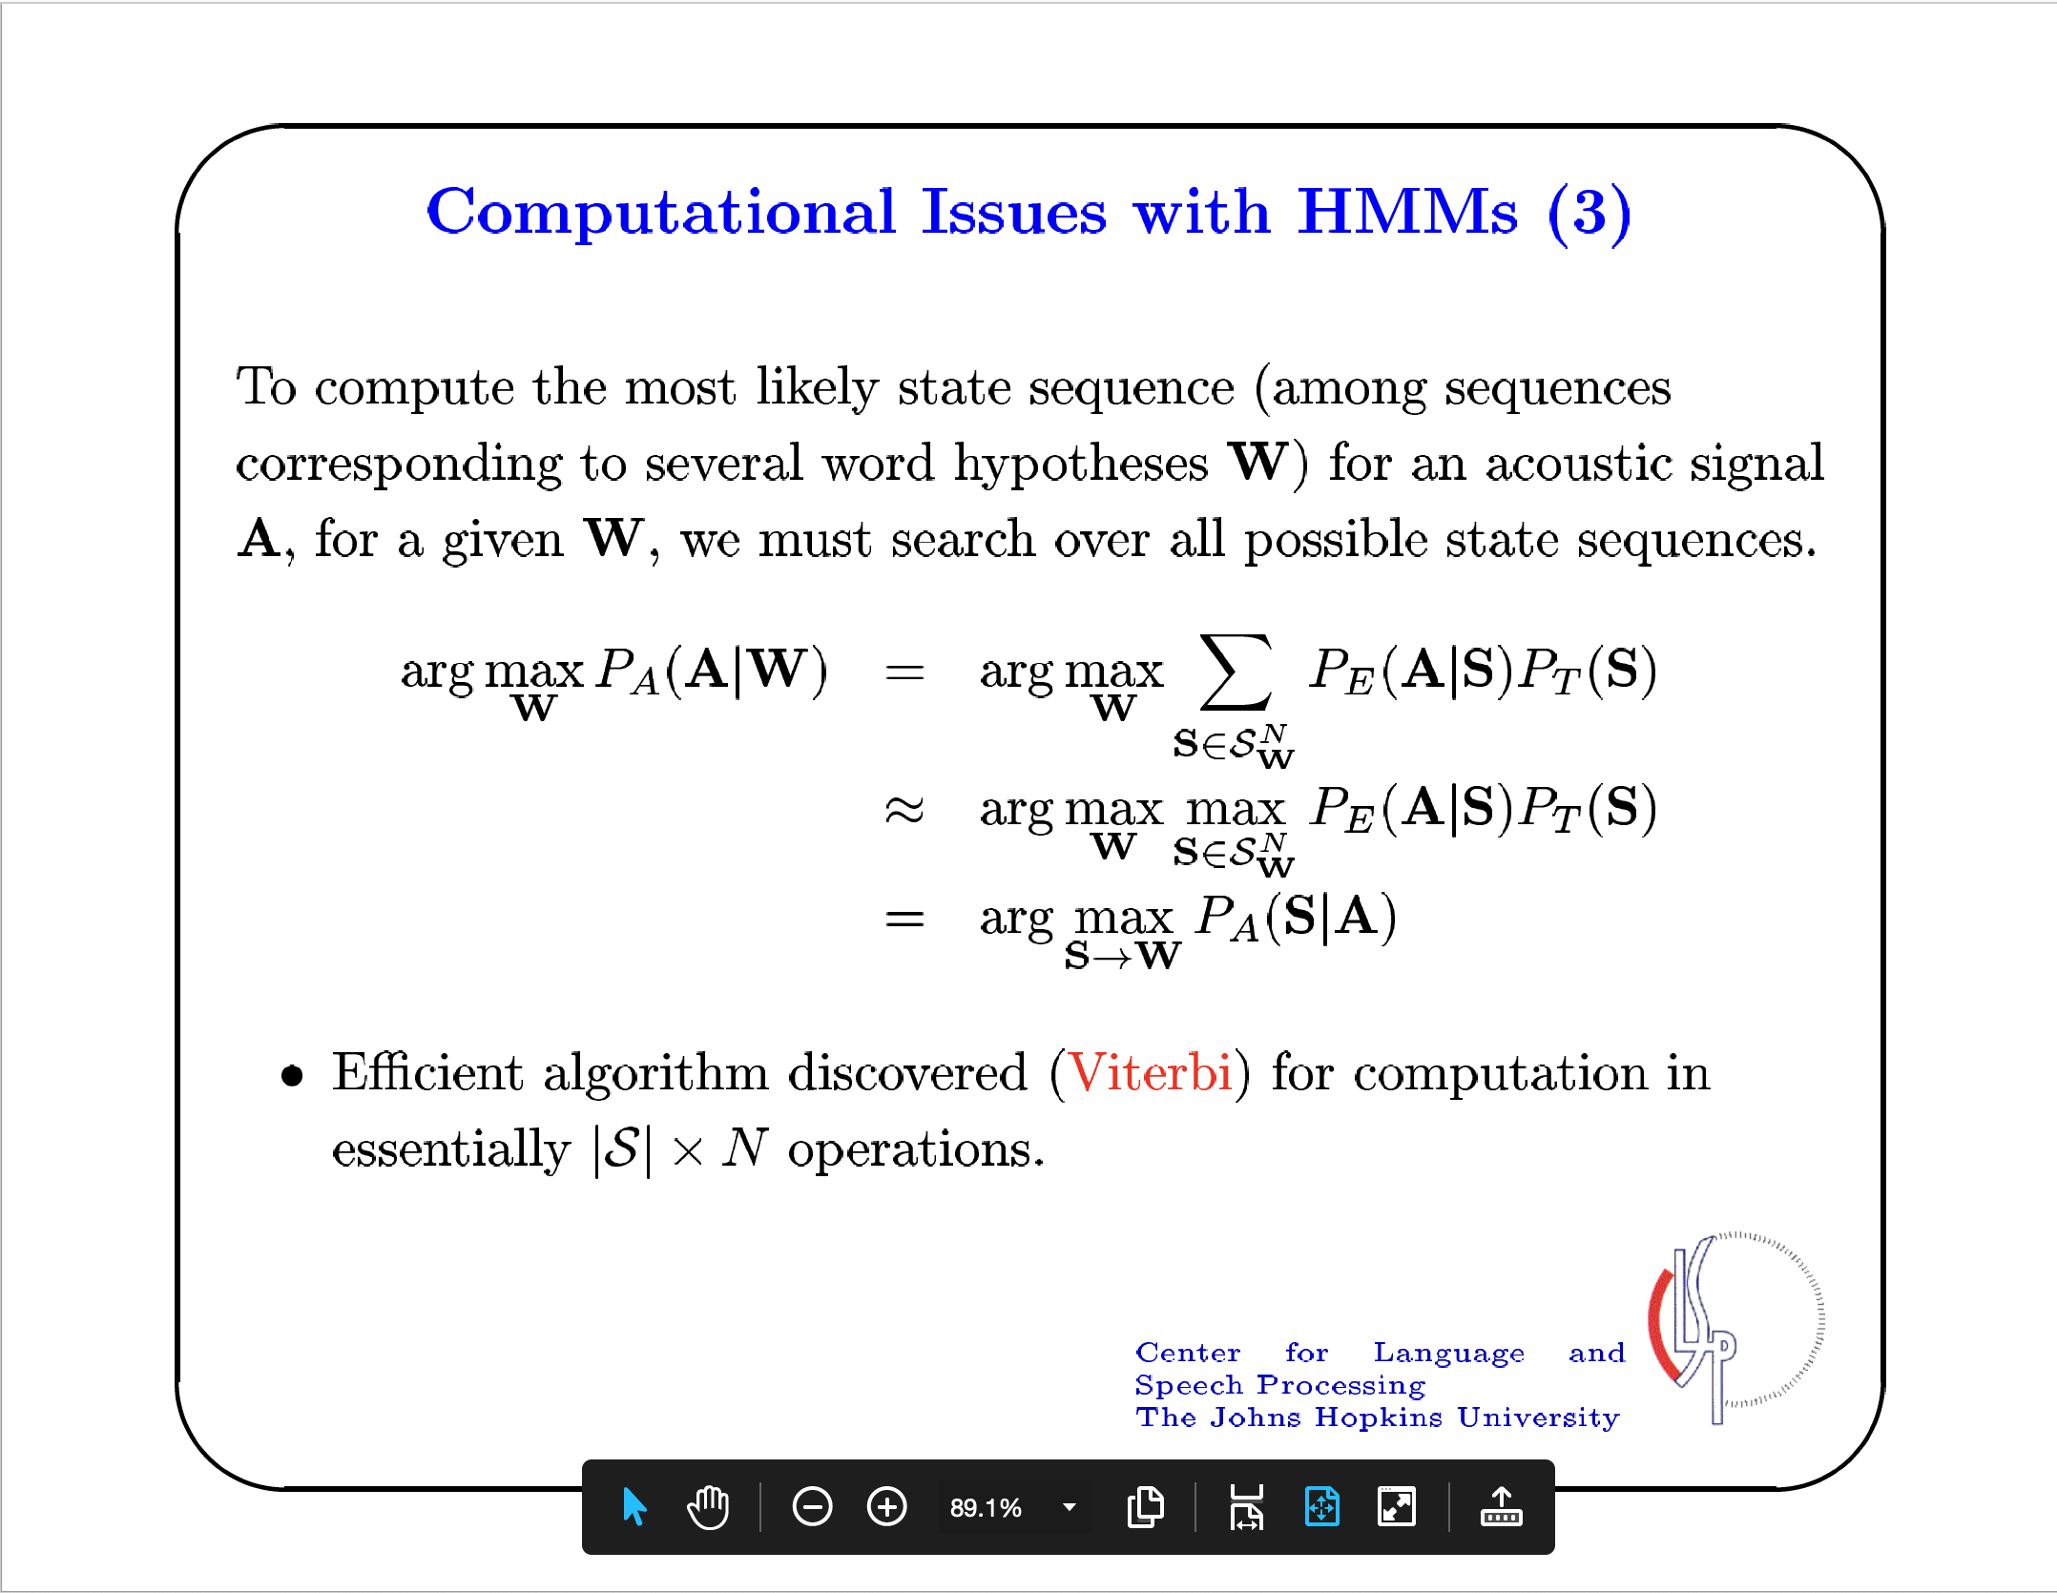

Slide 18
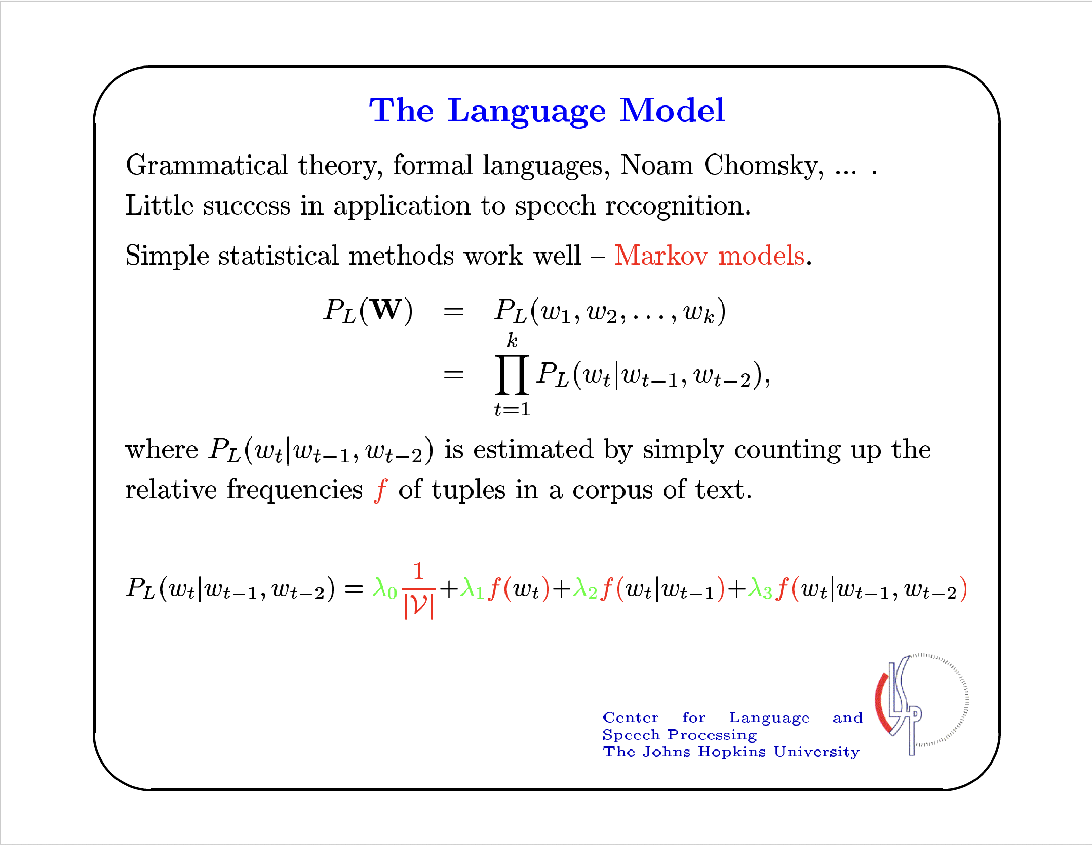

Slide 19
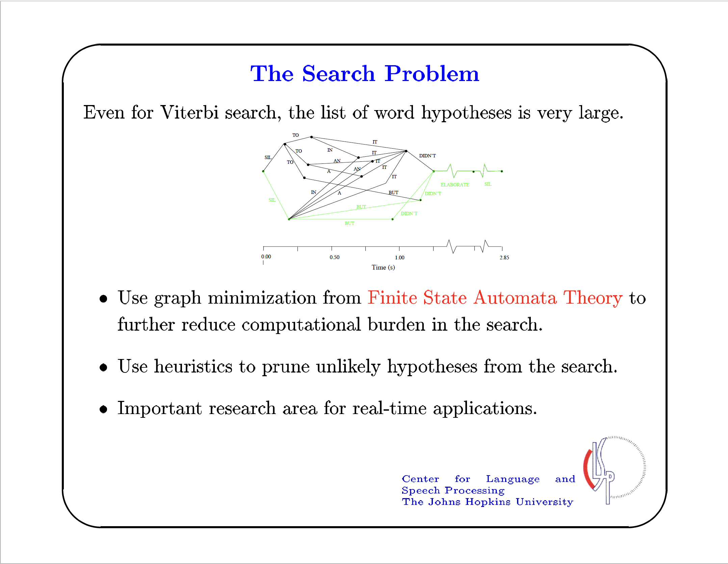

Slide 20
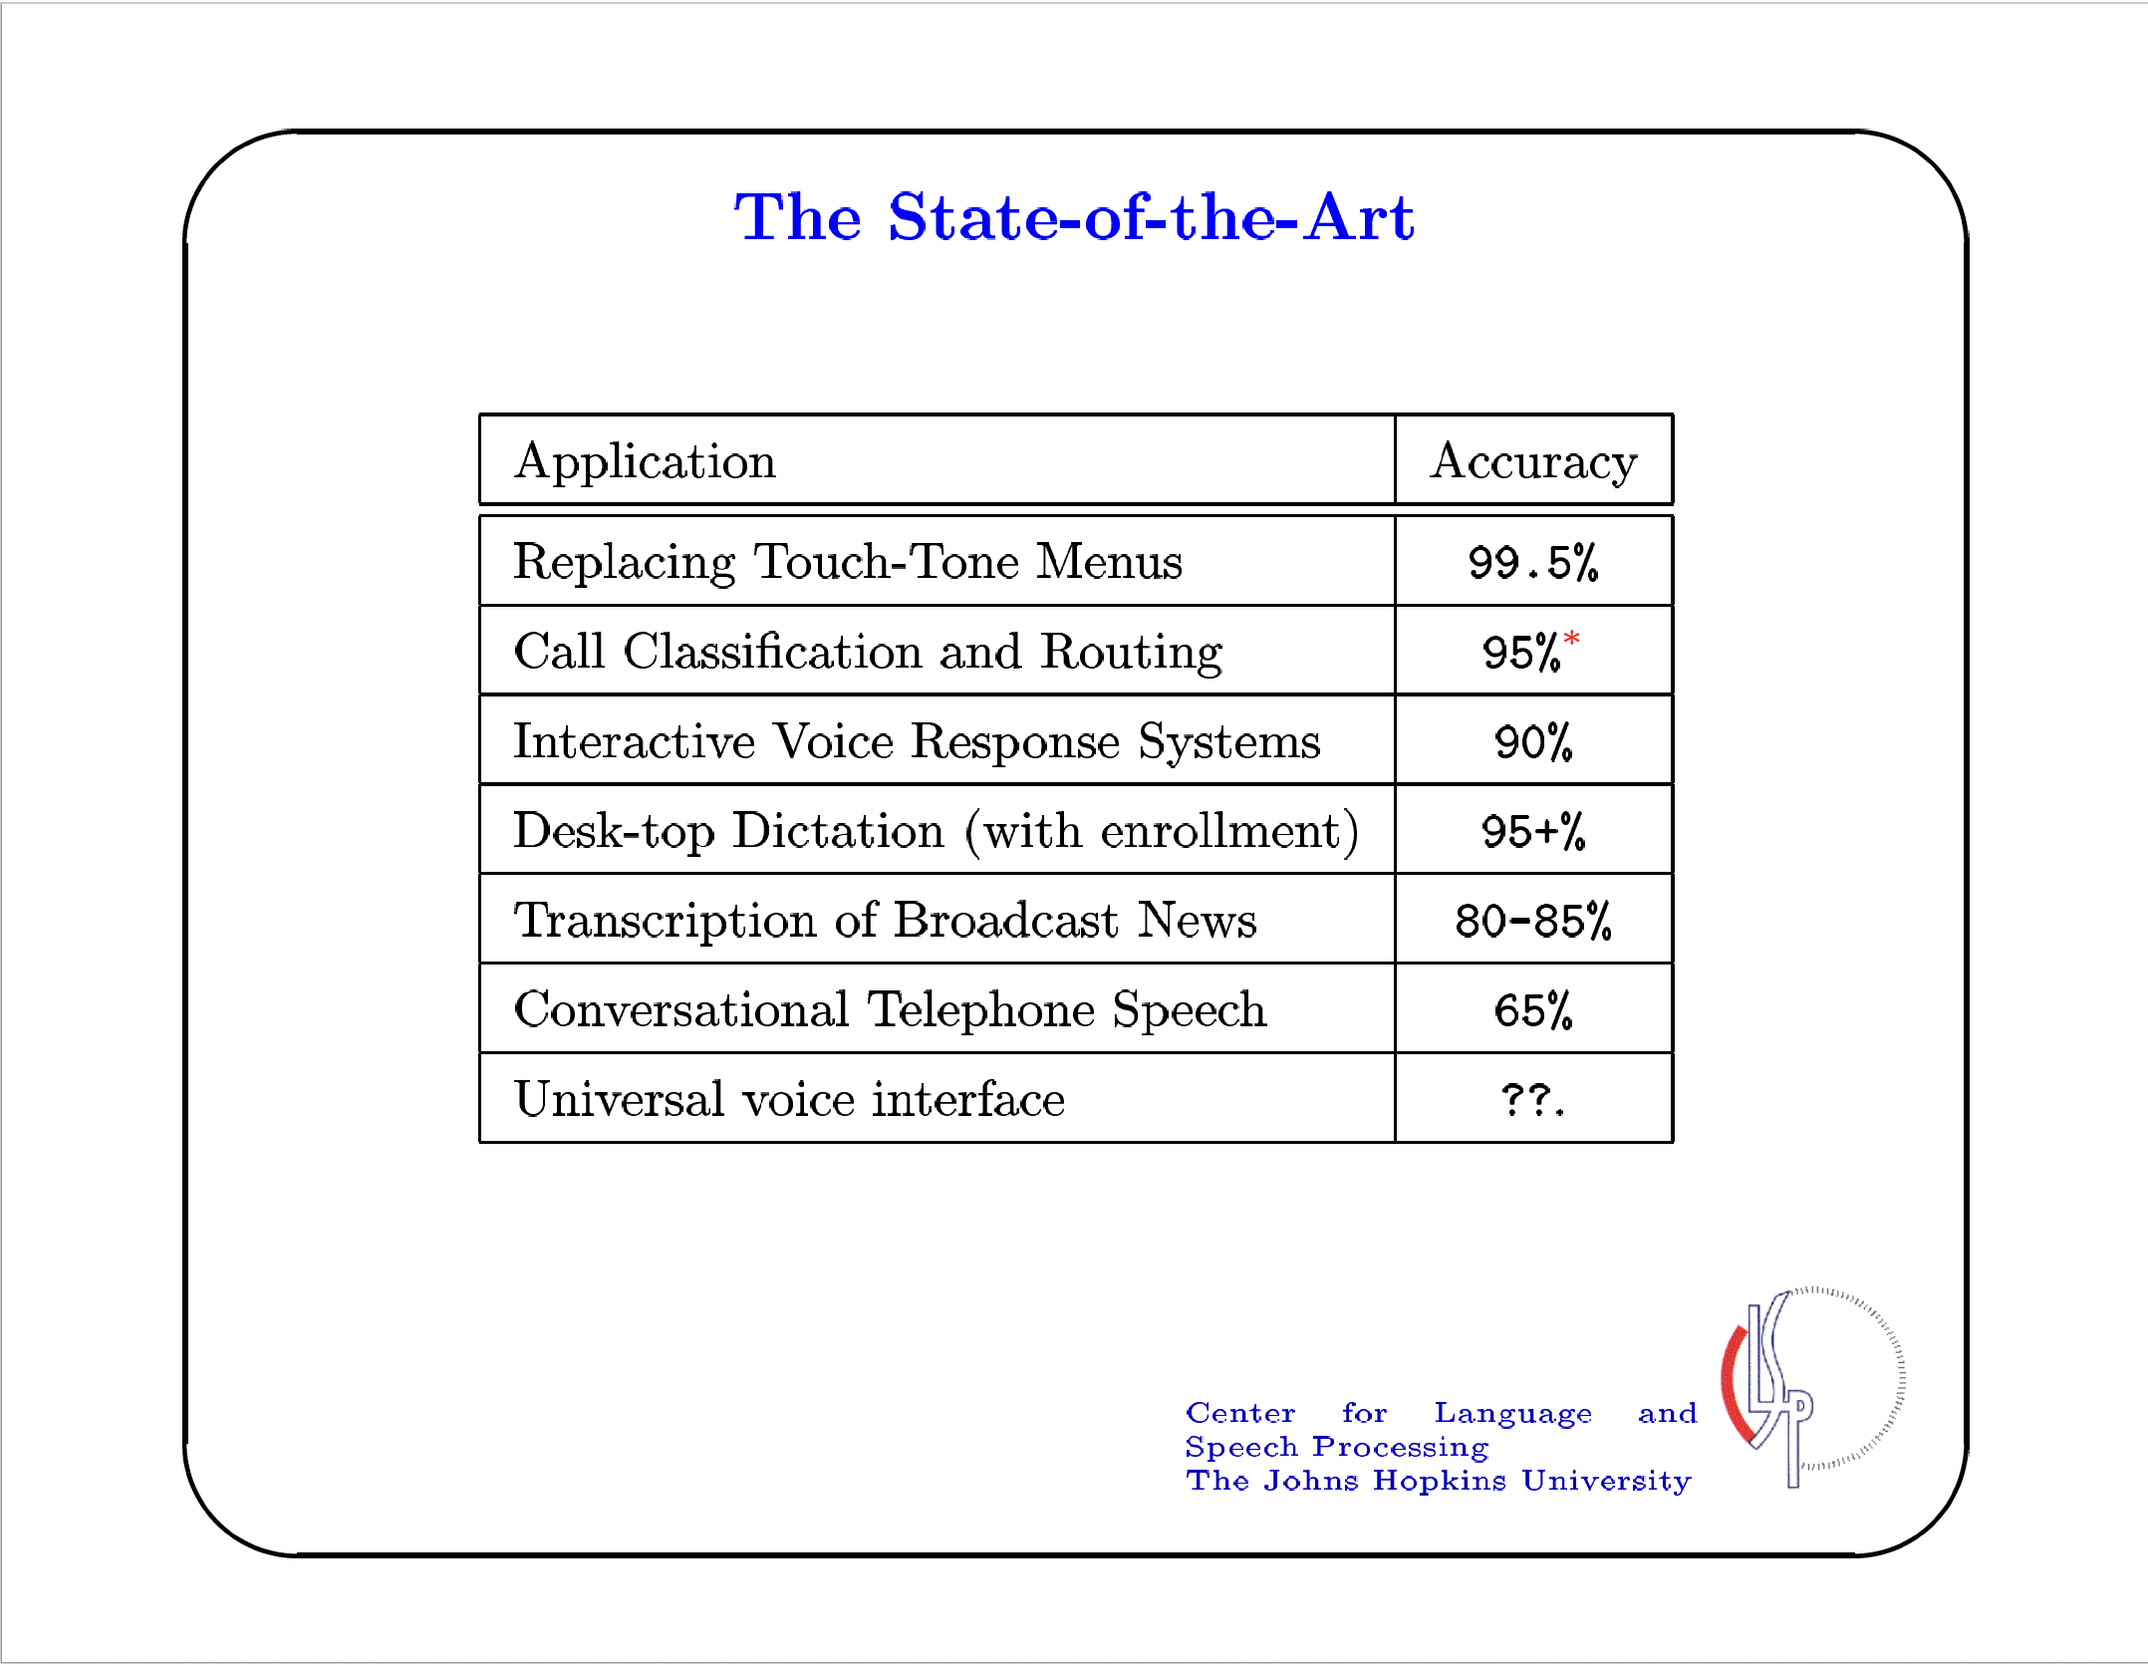

Slide 21
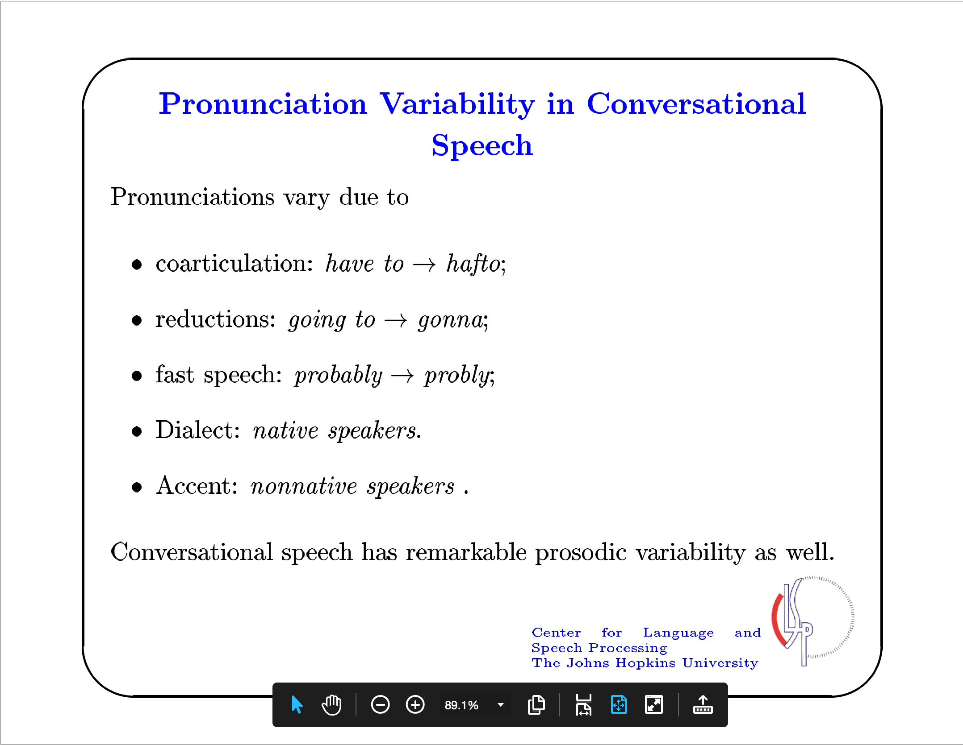

Slide 22
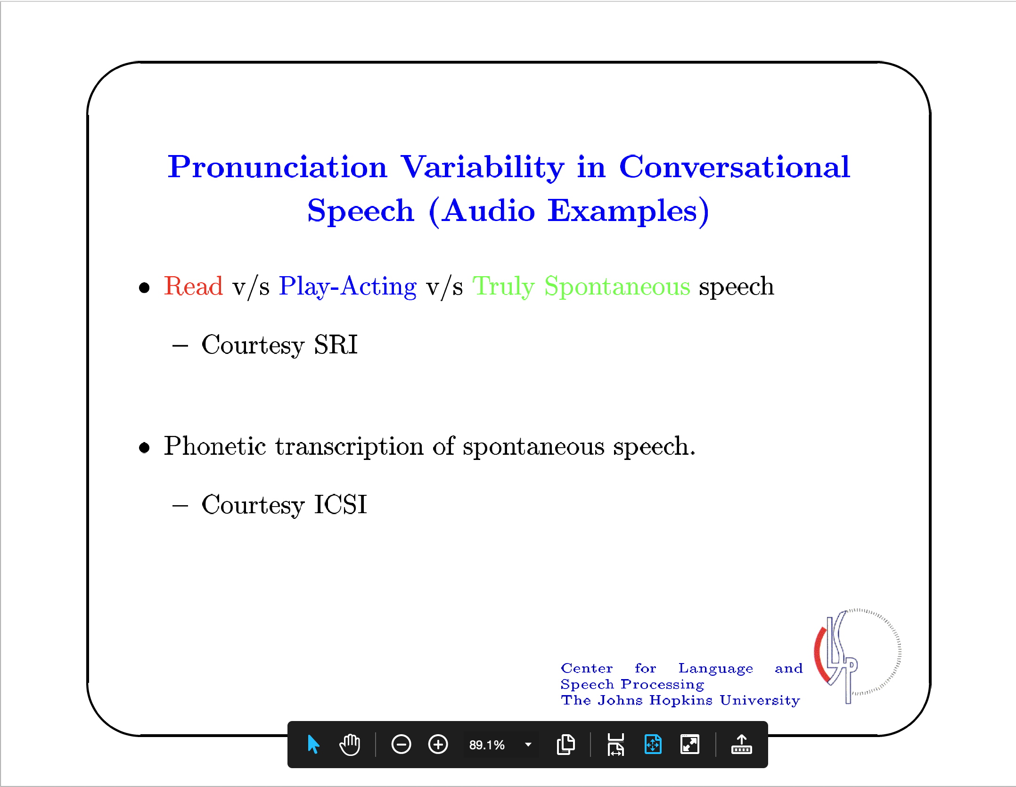

Slide 23
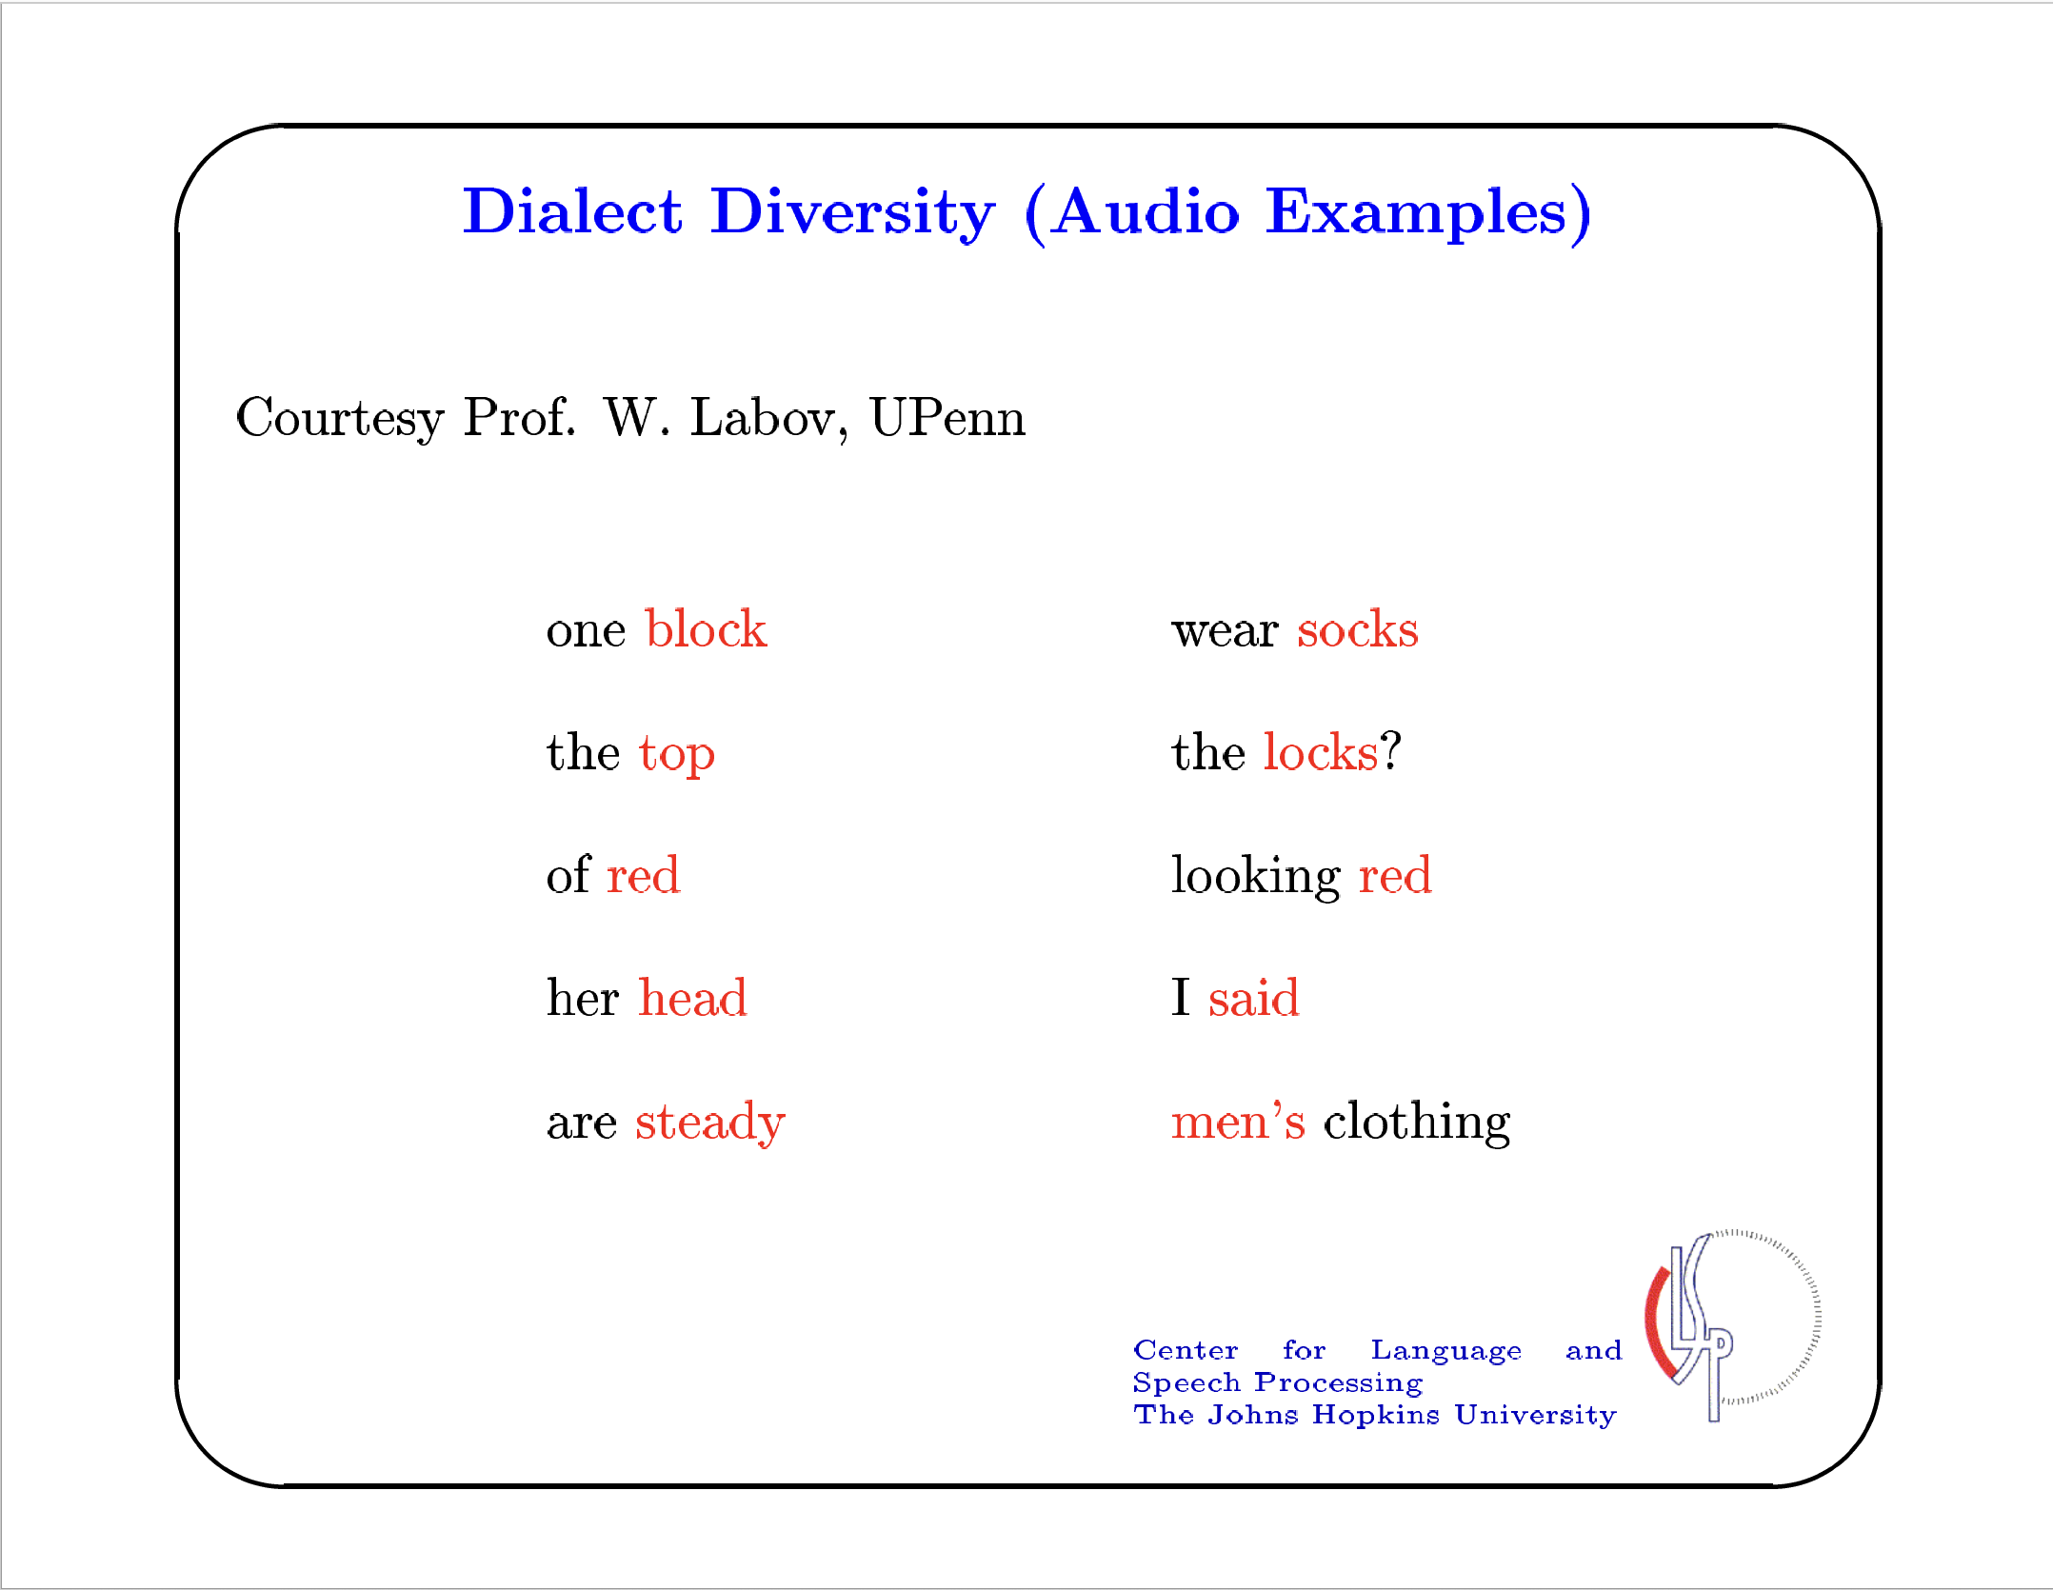

Slide 24
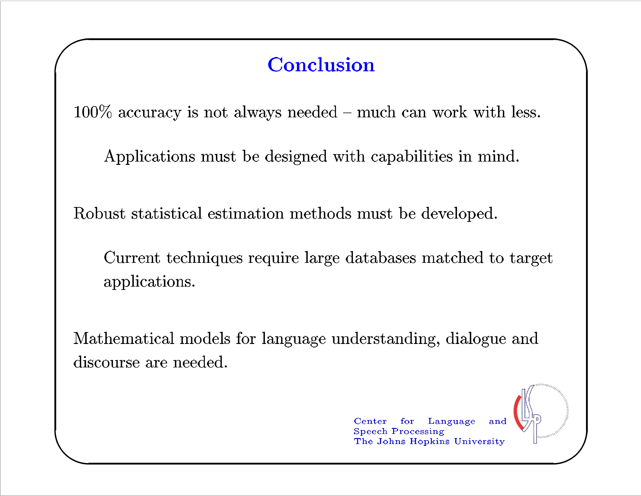

Slide 25
Neural Methods
in Automatic Speech Recognition
Neural Acoustic Models: Waibel et al (1988) to Povey et al (2016)
Neural Language Models: Nakamura et al (1989) to Sundermeyer et al (2012)
Connectionist Temporal Classification: Graves (2006) and Graves & Jaitly (2014)
Recurrent Neural Transduction: Graves (2012) to He et al (2019)
Deep Speech 2: Hannun et al (2014) and Attention-Based Models: Chorowski et al (2015)

Slide 26

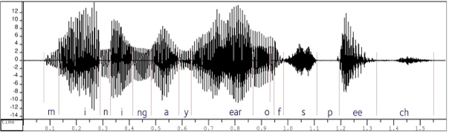
The “source-channel” model for automatic speech recognition (ASR)
Speaker’s Mind
Speaker’s Vocal Apparatus
Listener’s Auditory Apparatus
Listener’s Mind
Speaker’s Mind
W
Stochastic Communication Channel
A
Listener’s Mind
W*
P(W)
P(A|W)
arg max P(•|A)
Language Model
Acoustic Model
Decoder

Slide 27
Hidden Markov models became popular as acoustic models

Slide 28
Dynamic programming became popular for “decoding,” i.e. for hypothesis search

Slide 29
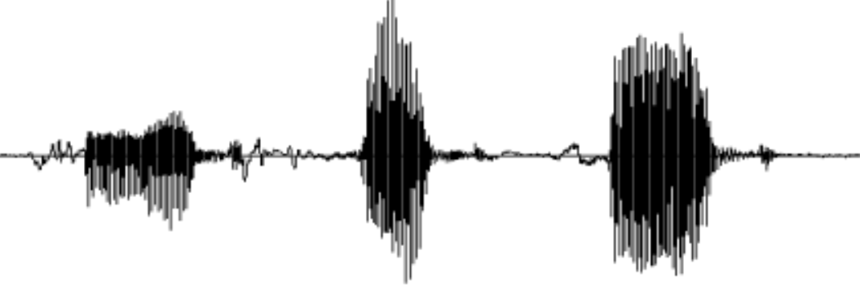
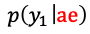
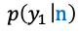
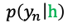
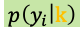
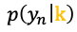
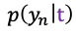
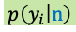
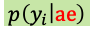

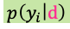
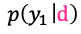

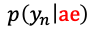
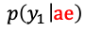
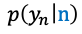

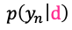
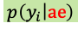
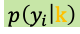
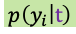


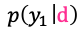
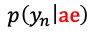
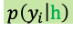
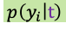

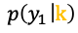


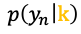

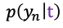


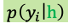
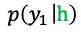
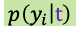
















Composite HMM for “cat and hat”
Phoneme
HMMs
$$p\left(y_{1} | \text{k}\right)$$
$$p\left(y_{i} | \text{k}\right)$$
$$p\left(y_{n} | \text{k}\right)$$
k
$$p\left(y_{1} | \text{k}\right)$$
$$p\left(y_{i} | \text{k}\right)$$
$$p\left(y_{n} | \text{k}\right)$$
$$p\left(y_{1} | \text{ae}\right)$$
$$p\left(y_{i} | \text{ae}\right)$$
$$p\left(y_{n} | \text{ae}\right)$$
ae
$$p\left(y_{1} | \text{ae}\right)$$
$$p\left(y_{i} | \text{ae}\right)$$
$$p\left(y_{n} | \text{ae}\right)$$
ae
$$p\left(y_{1} | \text{t}\right)$$
$$p\left(y_{i} | \text{t}\right)$$
$$p\left(y_{n} | \text{t}\right)$$
t
$$p\left(y_{1} | \text{t}\right)$$
$$p\left(y_{i} | \text{t}\right)$$
$$p\left(y_{n} | \text{t}\right)$$
d
$$p\left(y_{1} | \text{ae}\right)$$
$$p\left(y_{i} | \text{ae}\right)$$
$$p\left(y_{n} | \text{ae}\right)$$
ae
$$p\left(y_{1} | \text{ae}\right)$$
$$p\left(y_{i} | \text{ae}\right)$$
$$p\left(y_{n} | \text{ae}\right)$$
cat and hat
$$p\left(y_{1} | \text{n}\right)$$
$$p\left(y_{i} | \text{n}\right)$$
$$p\left(y_{n} | \text{n}\right)$$
h
n
$$p\left(y_{1} | \text{n}\right)$$
$$p\left(y_{i} | \text{n}\right)$$
$$p\left(y_{n} | \text{n}\right)$$
$$p\left(y_{1} | \text{d}\right)$$
$$p\left(y_{i} | \text{d}\right)$$
$$p\left(y_{n} | \text{d}\right)$$
k
d
$$p\left(y_{1} | \text{d}\right)$$
$$p\left(y_{i} | \text{d}\right)$$
$$p\left(y_{n} | \text{d}\right)$$
and ae n d
cat k ae t
hat h ae t
$$p\left(y_{1} | \text{h}\right)$$
$$p\left(y_{i} | \text{h}\right)$$
$$p\left(y_{n} | \text{h}\right)$$
h
$$p\left(y_{1} | \text{h}\right)$$
$$p\left(y_{i} | \text{h}\right)$$
$$p\left(y_{n} | \text{h}\right)$$
n
$$p\left(y_{n} | \text{ae}\right)$$
$$p\left(y_{1} | \text{ae}\right)$$
$$p\left(y_{i} | \text{ae}\right)$$
ae
$$p\left(y_{1} | \text{ae}\right)$$
$$p\left(y_{i} | \text{ae}\right)$$
$$p\left(y_{n} | \text{ae}\right)$$
t
$$p\left(y_{1} | \text{t}\right)$$
$$p\left(y_{i} | \text{t}\right)$$
$$p\left(y_{n} | \text{t}\right)$$
t
$$p\left(y_{1} | \text{t}\right)$$
$$p\left(y_{i} | \text{t}\right)$$
$$p\left(y_{n} | \text{t}\right)$$

Slide 30












Composite HMM for “cat and hat”
k
“Forward” Algorithm
$$p\left(y_{i} | \text{k}\right)$$
ae
$$P\left(y | w\right)=\sum_{s∈𝒮\left(w\right)}{P_{θ}\left(y | s\right)P_{τ}\left(s\right)}$$
$$p\left(y_{i} | \text{ae}\right)$$
t
$$p\left(y_{i} | \text{t}\right)$$
$$=\sum_{s∈𝒮\left(w\right)}{\prod_{i=1}^{n}{P_{θ}\left(y_{i} | s_{i}\right)P_{τ}\left(s_{i} | s_{i−1}\right)}}$$
ae
$$p\left(y_{i} | \text{ae}\right)$$
n
$$p\left(y_{i} | \text{n}\right)$$
Viterbi Algorithm
d
$$p\left(y_{i} | \text{d}\right)$$
$$\hat{s}=\arg{\max_{s∈𝒮\left(w\right)}{P\left(s | y\right)}}$$
h
$$p\left(y_{i} | \text{h}\right)$$
$$=\arg{\max_{s∈𝒮\left(w\right)}{\frac{P\left(y,s\right)}{P\left(y\right)}}}$$
ae
$$=\arg{\max_{s∈𝒮\left(w\right)}{\prod_{i=1}^{n}{P_{θ}\left(y_{i} | s_{i}\right)P_{τ}\left(s_{i} | s_{i−1}\right)}}}$$
t

Slide 31
Acoustic Modeling with Deep Neural Networks for Hybrid ASR Systems
Repurposing Algorithms Developed for HMM-based Architectures

Slide 32


A paper appeared in September 2011 …
ICASSP 1988

Slide 33

So, a lot of progress has been made since 1988

Slide 34









Phoneme
HMMs
Phoneme
Posterior Probabilities
Acoustic
Likelihoods
$$p\left(y_{i} | ϕ\right)=\frac{p\left(ϕ | y_{i}\right)p\left(y_{i}\right)}{p\left(ϕ\right)}∝\frac{p\left(ϕ | y_{i}\right)}{p\left(ϕ\right)}$$
$$p\left(\text{h} | y_{i}\right)$$
ae
d
h
k
n
t
ae
d
h
k
n
t
ae
$$p\left(y_{i} | \text{ae}\right)$$
d
$$p\left(y_{i} | \text{d}\right)$$
h
$$p\left(y_{i} | \text{h}\right)$$
k
$$p\left(y_{i} | \text{k}\right)$$
n
$$p\left(y_{i} | \text{n}\right)$$
t
$$p\left(y_{i} | \text{t}\right)$$
$$ℒ_{CE}\left(θ\right)=−\sum_{i=1}^{n}{\log{p_{θ}\left({\hat{φ}}_{i} | y_{i}\right)}}$$

Slide 35

Maximum Mutual Information Estimation

Slide 36



k k k k k k k k k k k k k k k k k ae t ae n d h ae t
⋮ ⋮ ⋮ ⋮ ⋮ ⋮ ⋮ ⋮ ⋮ ⋮ ⋮ ⋮ ⋮ ⋮ ⋮ ⋮ ⋮ ⋮ ⋮ ⋮ ⋮ ⋮ ⋮ ⋮ ⋮
k k k ae ae ae ae t t ae ae ae n n d d h h h h ae ae ae t t
⋮ ⋮ ⋮ ⋮ ⋮ ⋮ ⋮ ⋮ ⋮ ⋮ ⋮ ⋮ ⋮ ⋮ ⋮ ⋮ ⋮ ⋮ ⋮ ⋮ ⋮ ⋮ ⋮ ⋮ ⋮
k ae t ae n d h ae t t t t t t t t t t t t t t t t t
$$p_{θ}\left(Φ | y\right)=\sum_{t}{\prod_{i=1}^{n}{p_{θ}\left(φ_{t_{i}} | y_{i}\right)}}$$
$$p_{θ}\left(Φ | y\right)=\frac{p_{θ}\left(y | Φ\right)p\left(Φ\right)}{p_{θ}\left(y\right)}$$
$$ℒ_{MMI}\left(θ\right)=\log{\frac{p_{θ}\left(y | Φ\right)}{\sum_{\tilde{Φ}}{p_{θ}\left(y | \tilde{Φ}\right)p\left(\tilde{Φ}\right)}}}$$

Slide 37
Language Modeling with Recurrent Neural Networks
Efforts to Go Beyond n-gram Dependence in Language Models

Slide 38





Using Neural Networks to Estimate $P\left(w_{t} | h_{t}\right)$
ICASSP 1989

Slide 39


A paper appeared in September 2010 …

Slide 40




$$w_{t−1}$$
$$w_{t}$$
$$w_{t+1}$$
$$s_{t−2}$$
$$s_{t−1}$$
$$s_{t}$$
+
+
+
A Simple RNN
Language Model
0001000000000000000000
0000000000000000000100
0000000010000000000000
$$w_{t−2}$$
$$w_{t−1}$$
$$w_{t}$$
$$w_{t−1}$$
$$w_{t}$$
$$w_{t+1}$$
$$s_{t−2}$$
$$s_{t−1}$$
$$s_{t}$$
$$c_{t−2}$$
$$c_{t−1}$$
$$c_{t}$$
+
+
+
An RNN LSTM
Language Model
0001000000000000000000
0000000000000000000100
0000000010000000000000
$$w_{t−2}$$
$$w_{t−1}$$
$$w_{t}$$

Slide 41

Training Neural Networks without using HMM-Based Alignments

Slide 42
Phoneme
HMMs
Phoneme
Posterior Probabilities
$$p\left(y_{i} | φ\right)=\frac{p\left(φ | y_{i}\right)p\left(y_{i}\right)}{p\left(φ\right)}∝\frac{p\left(φ | y_{i}\right)}{p\left(φ\right)}$$
$$p\left(φ | y_{i}\right)$$
ae
d
h
k
n
t
ae
d
h
k
n
t
ae
d
FC
“cat and hat”
h
FC
CNN
k
CNN
n
CNN
t
CNN
$$ℒ_{\text{CE}}\left(θ\right)=−\log{\prod_{i=1}^{n}{p_{θ}\left({\hat{φ}}_{i} | y_{i}\right)=}}−\sum_{i=1}^{n}{\log{p_{θ}\left({\hat{φ}}_{i} | y_{i}\right)}}$$

Slide 43
FC
FC
CNN
CNN
CNN
CNN

Slide 44


k
ae
t
ae
n
d
h
ae
t
FC
FC
FC
FC
FC
FC
FC
FC
FC
FC
FC
FC
FC
FC
FC
FC
FC
FC
FC
FC
FC
FC
FC
FC
FC
FC
FC
FC
FC
FC
FC
FC
FC
FC
FC
FC
FC
FC
FC
FC
FC
FC
FC
FC
FC
FC
FC
FC
FC
FC
CNN
CNN
CNN
CNN
CNN
CNN
CNN
CNN
CNN
CNN
CNN
CNN
CNN
CNN
CNN
CNN
CNN
CNN
CNN
CNN
CNN
CNN
CNN
CNN
CNN
CNN
CNN
CNN
CNN
CNN
CNN
CNN
CNN
CNN
CNN
CNN
CNN
CNN
CNN
CNN
CNN
CNN
CNN
CNN
CNN
CNN
CNN
CNN
CNN
CNN
CNN
CNN
CNN
CNN
CNN
CNN
CNN
CNN
CNN
CNN
CNN
CNN
CNN
CNN
CNN
CNN
CNN
CNN
CNN
CNN
CNN
CNN
CNN
CNN
CNN
CNN
CNN
CNN
CNN
CNN
CNN
CNN
CNN
CNN
CNN
CNN
CNN
CNN
CNN
CNN
CNN
CNN
CNN
CNN
CNN
CNN
CNN
CNN
CNN
CNN
$$ℒ_{\text{CE}}\left(θ\right)=−\log{\prod_{i=1}^{n}{p_{θ}\left({\hat{φ}}_{i} | y_{i}\right)}}$$
$$ℒ_{\text{CTC}}\left(θ\right)=−\log{\sum_{ t}{\prod_{i=1}^{n}{p_{θ}\left(φ_{t_{i}} | y_{i}\right)}}}$$

Slide 45


Calculating the CTC loss for “cat and hat”
Calculating the gradient of the CTC loss
k
$$ℒ_{\text{CTC}}\left(θ\right)=−\log{\sum_{ t}{\prod_{i=1}^{n}{p_{θ}\left(φ_{t_{i}} | y_{i}\right)}}}$$
$$p\left(\text{k} | y_{i}\right)$$
ae
$$p\left(\text{ae} | y_{i}\right)$$
t
$$p\left(\text{t} | y_{i}\right)$$
$$ℒ_{\text{HMM}}\left(θ\right)=−\log{\sum_{ t}{\prod_{i=1}^{n}{p_{θ}\left(y_{i} | φ_{t_{i}}\right)p_{θ}\left(φ_{t_{i}} | φ_{t_{i−1}}\right)}}}$$
ae
$$p\left(\text{ae} | y_{i}\right)$$
FC
n
$$p\left(\text{n} | y_{i}\right)$$
FC
$$\frac{∂ℒ_{\text{CTC}}\left(θ\right)}{∂p_{θ}\left(φ | y_{j}\right)}=\frac{−1}{\sum_{ t}{\prod_{i=1}^{n}{p_{θ}\left(φ_{t_{i}} | y_{i}\right)}}}\sum_{t:φ_{t_{j}}=φ}{\frac{1}{p_{θ}\left(φ | y_{j}\right)}\prod_{i=1}^{n}{p_{θ}\left(φ_{t_{i}} | y_{i}\right)}}$$
d
$$p\left(\text{d} | y_{i}\right)$$
CNN
h
$$p\left(\text{h} | y_{i}\right)$$
CNN
ae
CNN
$$\frac{∂ℒ_{\text{CTC}}\left(θ\right)}{∂p_{θ}\left(φ | y_{j}\right)}=−\frac{1}{p_{θ}\left(φ | y_{j}\right)}\frac{\sum_{t:φ_{t_{j}}=φ}{\prod_{i=1}^{n}{p_{θ}\left(φ_{t_{i}} | y_{i}\right)}}}{\sum_{ t}{\prod_{i=1}^{n}{p_{θ}\left(φ_{t_{i}} | y_{i}\right)}}}$$
t
CNN
$$y_{i}$$
$$y_{j}$$

Slide 46
Composite HMM for “cat and hat”
cat and hat
k
ae
t
ae
n
d
h
ae
t
and ae n d
cat k ae t
hat h ae t
The CTC “Blank” Symbol (𝛽)
Phoneme
HMMs
FSA of permissible CTC strings for “cat and hat”
k
ae
t
ae
n
d
h
ae
t

Slide 47
k k k k k k k k k k k k k k k k k ae t ae n d h ae t
⋮ ⋮ ⋮ ⋮ ⋮ ⋮ ⋮ ⋮ ⋮ ⋮ ⋮ ⋮ ⋮ ⋮ ⋮ ⋮ ⋮ ⋮ ⋮ ⋮ ⋮ ⋮ ⋮ ⋮ ⋮
k k k ae ae ae ae t t ae ae ae n n d d h h h h ae ae ae t t
⋮ ⋮ ⋮ ⋮ ⋮ ⋮ ⋮ ⋮ ⋮ ⋮ ⋮ ⋮ ⋮ ⋮ ⋮ ⋮ ⋮ ⋮ ⋮ ⋮ ⋮ ⋮ ⋮ ⋮ ⋮
k ae t ae n d h ae ae t t t t t t t t t t t t t t t t
HMM State
Sequences
𝛽 𝛽 𝛽 𝛽 𝛽 𝛽 𝛽 𝛽 𝛽 𝛽 𝛽 𝛽 𝛽 𝛽 𝛽 𝛽 k ae t ae n d h ae t
⋮ ⋮ ⋮ ⋮ ⋮ ⋮ ⋮ ⋮ ⋮ ⋮ ⋮ ⋮ ⋮ ⋮ ⋮ ⋮ ⋮ ⋮ ⋮ ⋮ ⋮ ⋮ ⋮ ⋮ ⋮
𝛽 k 𝛽 𝛽 ae ae 𝛽 t 𝛽 𝛽 ae 𝛽 𝛽 n d d h 𝛽 𝛽 𝛽 𝛽 𝛽 𝛽 ae t
⋮ ⋮ ⋮ ⋮ ⋮ ⋮ ⋮ ⋮ ⋮ ⋮ ⋮ ⋮ ⋮ ⋮ ⋮ ⋮ ⋮ ⋮ ⋮ ⋮ ⋮ ⋮ ⋮ ⋮ ⋮
k ae t ae n d h ae t 𝛽 𝛽 𝛽 𝛽 𝛽 𝛽 𝛽 𝛽 𝛽 𝛽 𝛽 𝛽 𝛽 𝛽 𝛽 𝛽
CTC Symbol
Sequences

Slide 48

k
ae
t
ae
n
d
h
ae
t
FC
FC
FC
FC
FC
FC
FC
FC
FC
FC
FC
FC
FC
FC
FC
FC
FC
FC
FC
FC
FC
FC
FC
FC
FC
FC
FC
FC
FC
FC
FC
FC
FC
FC
FC
FC
FC
FC
FC
FC
FC
FC
FC
FC
FC
FC
FC
FC
FC
FC
CNN
CNN
CNN
CNN
CNN
CNN
CNN
CNN
CNN
CNN
CNN
CNN
CNN
CNN
CNN
CNN
CNN
CNN
CNN
CNN
CNN
CNN
CNN
CNN
CNN
CNN
CNN
CNN
CNN
CNN
CNN
CNN
CNN
CNN
CNN
CNN
CNN
CNN
CNN
CNN
CNN
CNN
CNN
CNN
CNN
CNN
CNN
CNN
CNN
CNN
CNN
CNN
CNN
CNN
CNN
CNN
CNN
CNN
CNN
CNN
CNN
CNN
CNN
CNN
CNN
CNN
CNN
CNN
CNN
CNN
CNN
CNN
CNN
CNN
CNN
CNN
CNN
CNN
CNN
CNN
CNN
CNN
CNN
CNN
CNN
CNN
CNN
CNN
CNN
CNN
CNN
CNN
CNN
CNN
CNN
CNN
CNN
CNN
CNN
CNN
$$ℒ_{\text{CTC}}\left(θ\right)=−\log{\sum_{ t}{\prod_{i=1}^{n}{p_{θ}\left(φ_{t_{i}} | y_{i}\right)}}}$$

Slide 49
Neural Speech Recognition without HMMs (aka End2End ASR)
“Purely” CTC-Based Speech Recognition Architectures

Slide 50



End-to-End Speech Recognition

Slide 51
The CNN Architecture
FC
FC
FC
FC
FC
FC
FC
FC
FC
FC
FC
FC
FC
FC
FC
FC
FC
FC
FC
FC
FC
FC
FC
FC
FC
FC
FC
FC
FC
FC
FC
FC
FC
FC
FC
FC
FC
FC
FC
FC
FC
FC
FC
FC
FC
FC
FC
FC
FC
FC
CNN
CNN
CNN
CNN
CNN
CNN
CNN
CNN
CNN
CNN
CNN
CNN
CNN
CNN
CNN
CNN
CNN
CNN
CNN
CNN
CNN
CNN
CNN
CNN
CNN
CNN
CNN
CNN
CNN
CNN
CNN
CNN
CNN
CNN
CNN
CNN
CNN
CNN
CNN
CNN
CNN
CNN
CNN
CNN
CNN
CNN
CNN
CNN
CNN
CNN
CNN
CNN
CNN
CNN
CNN
CNN
CNN
CNN
CNN
CNN
CNN
CNN
CNN
CNN
CNN
CNN
CNN
CNN
CNN
CNN
CNN
CNN
CNN
CNN
CNN
CNN
CNN
CNN
CNN
CNN
CNN
CNN
CNN
CNN
CNN
CNN
CNN
CNN
CNN
CNN
CNN
CNN
CNN
CNN
CNN
CNN
CNN
CNN
CNN
CNN

Slide 52
The CNN+LSTM Architecture
FC
FC
FC
FC
FC
FC
FC
FC
FC
FC
FC
FC
FC
FC
FC
FC
FC
FC
FC
FC
FC
FC
FC
FC
FC
FC
FC
FC
FC
FC
FC
FC
FC
FC
FC
FC
FC
FC
FC
FC
FC
FC
FC
FC
FC
FC
FC
FC
FC
FC
LSTM
LSTM
LSTM
LSTM
LSTM
LSTM
LSTM
LSTM
LSTM
LSTM
LSTM
LSTM
LSTM
LSTM
LSTM
LSTM
LSTM
LSTM
LSTM
LSTM
LSTM
LSTM
LSTM
LSTM
LSTM
LSTM
LSTM
LSTM
LSTM
LSTM
LSTM
LSTM
LSTM
LSTM
LSTM
LSTM
LSTM
LSTM
LSTM
LSTM
LSTM
LSTM
LSTM
LSTM
LSTM
LSTM
LSTM
LSTM
LSTM
LSTM
CNN
CNN
CNN
CNN
CNN
CNN
CNN
CNN
CNN
CNN
CNN
CNN
CNN
CNN
CNN
CNN
CNN
CNN
CNN
CNN
CNN
CNN
CNN
CNN
CNN
CNN
CNN
CNN
CNN
CNN
CNN
CNN
CNN
CNN
CNN
CNN
CNN
CNN
CNN
CNN
CNN
CNN
CNN
CNN
CNN
CNN
CNN
CNN
CNN
CNN

Slide 53
A Bidirectional LSTM Architecture (Deep Speech)
FC
FC
FC
FC
FC
FC
FC
FC
FC
FC
FC
FC
FC
FC
FC
FC
FC
FC
FC
FC
FC
FC
FC
FC
FC
LSTM
LSTM
LSTM
LSTM
LSTM
LSTM
LSTM
LSTM
LSTM
LSTM
LSTM
LSTM
LSTM
LSTM
LSTM
LSTM
LSTM
LSTM
LSTM
LSTM
LSTM
LSTM
LSTM
LSTM
LSTM
LSTM
LSTM
LSTM
LSTM
LSTM
LSTM
LSTM
LSTM
LSTM
LSTM
LSTM
LSTM
LSTM
LSTM
LSTM
LSTM
LSTM
LSTM
LSTM
LSTM
LSTM
LSTM
LSTM
LSTM
LSTM
CNN
CNN
CNN
CNN
CNN
CNN
CNN
CNN
CNN
CNN
CNN
CNN
CNN
CNN
CNN
CNN
CNN
CNN
CNN
CNN
CNN
CNN
CNN
CNN
CNN
CNN
CNN
CNN
CNN
CNN
CNN
CNN
CNN
CNN
CNN
CNN
CNN
CNN
CNN
CNN
CNN
CNN
CNN
CNN
CNN
CNN
CNN
CNN
CNN
CNN
CNN
CNN
CNN
CNN
CNN
CNN
CNN
CNN
CNN
CNN
CNN
CNN
CNN
CNN
CNN
CNN
CNN
CNN
CNN
CNN
CNN
CNN
CNN
CNN
CNN

Slide 54
End-to-End Speech Recognition using Neural Networks with Attention
Applying ideas from machine translation to speech recognition

Slide 55


Attention-Based Speech Recognition
NeurIPS 2015

Slide 56



An Encoder-Decoder Architecture with Attention
k
ae
t
ae
n
d
h
ae
t
</s>
Decoder
Network
LSTM
LSTM
LSTM
LSTM
LSTM
LSTM
LSTM
LSTM
LSTM
LSTM
$$g_{i}=\sum_{j}{α_{i,j}h_{j}}$$
<s>
Attention
Mechanism
$$e_{i,j}=\left\langle φ\left(s_{i−1}\right),ψ\left(h_{j}\right)\right\rangle$$
$$α_{i,j}=\frac{\exp{e_{i,j}}}{\sum_{j^{′}}{{exp e}_{i,j^{′}}}}$$
LSTM
LSTM
LSTM
LSTM
LSTM
LSTM
LSTM
LSTM
LSTM
LSTM
LSTM
LSTM
Encoder Network
LSTM
LSTM
LSTM
LSTM
LSTM
LSTM
LSTM
LSTM
LSTM
LSTM
LSTM
LSTM
LSTM
LSTM
LSTM
LSTM
LSTM
LSTM
LSTM
LSTM
LSTM
LSTM
LSTM
LSTM
LSTM
LSTM
LSTM
LSTM
LSTM
LSTM
LSTM
LSTM
LSTM
LSTM
LSTM
LSTM
LSTM
LSTM
LSTM
LSTM
LSTM
LSTM
LSTM
LSTM
LSTM
LSTM
LSTM
LSTM
LSTM
LSTM
LSTM
LSTM
LSTM
LSTM
LSTM
LSTM
LSTM
LSTM
LSTM
LSTM

Slide 57
Recurrent Neural Network Transducers
Coming full circle to
the basic mathematical formulation of automatic speech recognition

Slide 58


There was another paper in 2012 …
ICASSP 2019
ICML 2012 Workshop on Representation Learning

Slide 59
Combining a fully neural acoustic model with a fully neural language model
Joiner
LSTM
LSTM
LSTM
LSTM
LSTM
LSTM
LSTM
LSTM
LSTM
LSTM
LSTM
LSTM
k
ae
t
ae
n
d
h
ae
t
</s>
Encoder Network
LSTM
LSTM
LSTM
LSTM
LSTM
LSTM
LSTM
LSTM
LSTM
LSTM
LSTM
LSTM
Prerdictor
Network
LSTM
LSTM
LSTM
LSTM
LSTM
LSTM
LSTM
LSTM
LSTM
LSTM
LSTM
LSTM
LSTM
LSTM
LSTM
LSTM
LSTM
LSTM
LSTM
LSTM
LSTM
LSTM
LSTM
LSTM
LSTM
LSTM
LSTM
LSTM
LSTM
LSTM
LSTM
LSTM
LSTM
LSTM
LSTM
LSTM
LSTM
LSTM
LSTM
LSTM
LSTM
LSTM
LSTM
LSTM
LSTM
LSTM
LSTM
LSTM
LSTM
LSTM
LSTM
LSTM
LSTM
LSTM
LSTM
LSTM
LSTM
LSTM
<s>

Slide 60
Summary + Q&A
Neural Acoustic Models: Waibel et al (1988) to Povey et al (2016)
Neural Language Models: Nakamura et al (1989) to Sundermeyer et al (2012)
Connectionist Temporal Classification: Graves (2006)
CTC-Based Models: Hannun et al (2014) and Graves & Jaitly (2014)
Attention-Based Models: Chorowski et al (2015)
Recurrent Neural Network Transducers: Graves (2012) to He et al (2019)

Slide 61
Self-Supervised Representation Learning
for Automatic Speech Recognition
From MMI for ASR to Self-Supervised Learning (SSL): Theory

Slide 62


Outline
Both approaches are fundamentally mutual information estimation
ASR Model
Conformer
Zipformer
Transformer
BLSTM
TDNN
Transcribed Text
الكالمات المكتوبة
SSL Model
Wav2Vec2.0
Hubert
11 4 2 4 4 3

Slide 63

Estimating Mutual Information
A quick review and some slight change in notation
Before the break you saw MMI and CTC
Neural Network Outputs
The lattice (graph) corresponding to the ground-truth transcript
$$ℒ_{MMI}\left(θ\right)=\log{\frac{p_{θ}\left(y | Φ\right)}{\sum_{\tilde{Φ}}{p_{θ}\left(y | \tilde{Φ}\right)p\left(\tilde{Φ}\right)}}}$$
Model Parameters

Slide 64

Estimating Mutual Information
A quick review and some slight change in notation
Before the break you saw MMI and CTC
Neural Network Outputs
The lattice (graph) corresponding to the ground-truth transcript
$$ℒ_{MMI}\left(θ\right)=\log{\frac{p_{θ}\left(y | Φ\right)}{\sum_{\tilde{Φ}}{p_{θ}\left(y | \tilde{Φ}\right)p\left(\tilde{Φ}\right)}}}$$
Rename where we are not explicitly considering the lattice, just a transcript, and $y$ , i.e., the input
Model Parameters
$$Φ$$

Slide 65
Estimating Mutual Information
What if our model outputs scores rather than properly normalized probability distributions?
This is roughly the LF-MMI (Purely sequence trained models) objective

Slide 66

Estimating Mutual Information
Quick review / intro to mutual information
Define some random variables which take values , i.e.,
Some properties
By KonradVoelkel - Own work, Public Domain, https://commons.wikimedia.org/w/index.php?curid=11245361

Slide 67
Estimating Mutual Information
How does the MMI objective relate to mutual information estimation?
By conditional probability chain rule

Slide 68
Estimating Mutual Information
How does the MMI objective relate to mutual information estimation?
Cancel in numerator and denominator

Slide 69
Estimating Mutual Information
How does the MMI objective relate to mutual information estimation?
We don’t know the true distribution , but we can introduce a new trainable distribution with parameters .

Slide 70
Estimating Mutual Information
How does the MMI objective relate to mutual information estimation?
Log of product is sum of logs

Slide 71
Estimating Mutual Information
How does the MMI objective relate to mutual information estimation?
Linearity of expectation and definition of the KL-divergence

Slide 72
Estimating Mutual Information
How does the MMI objective relate to mutual information estimation?
Non-negativity of KL-Divergence

Slide 73
Estimating Mutual Information
How does the MMI objective relate to mutual information estimation?
Proposal: Use
Then we have a new lower bound on MI
Minibatch estimate of the MI

Slide 74
Self-Supervised Models as Mutual information Estimators
MMI / CTC are training models to maximize a lower bound estimate of the mutual information between the input speech and its transcript!
It turns out self-supervised models are trained in the exact same way using different input-output pairs and/or different lower bounds
Speech with missing spans
Transcribed Text
Learned latent representations for the missing span (Wav2Vec2.0)
11 4 2 4 4 3
Fixed discrete labels for the speech (HuBERT)

Slide 75

Self-Supervised Models as Mutual information Estimators
We can use any other lower-bound on mutual information!
Examples: Donsker-Varadhan Bound, MINE, f-MINE, NWJ (Nguyen, Wainwright, and Jordan)
InfoNCE

Slide 76
InfoNCE in Practice
Score of a correct match should be high
Score of incorrect pairings should be low
Learned latent representations for the missing span (Wav2Vec2.0)
1. For 1 speech context
2. Keep around the corresponding ground-truth for the masked spans
3. Pick K-1 alternatives drawn INDEPENDENTLY to use as contrastive examples
SSL Model
Wav2Vec2.0
Hubert
Speech with missing spans when training

Slide 77

InfoNCE in Practice
Minibatch of Data
3 Examples
3 x 24 x 6 Minibatch
24, 6-d Frames

Slide 78
InfoNCE in Practice
Minibatch of Data
Some parts (darker shade) are the context used to predict representations for the masked out spans (lighter)

Slide 79
InfoNCE in Practice
Minibatch of Data
12 frames to predict in example 1
12 frames to predict in example 2
6 frames to predict in example 3

Slide 80
InfoNCE in Practice
Minibatch of Data
Consider the first example and assume IID elements in minibatch

Slide 81

InfoNCE in Practice
SOME THINGS TO WATCH OUT FOR!!
Use a large batch size!
Distractors Must be IID for good Mutual Information Estimate!
Tschannen, Michael, et al. "On mutual information maximization for representation learning." arXiv preprint arXiv:1907.13625 (2019).

Slide 82
InfoNCE in Practice
SOME THINGS TO WATCH OUT FOR!!
Good MI estimation does guarantee good performance in downstream task if using simple classifiers
Data processing Inequality
No subsequent layer in a computation graph neural network has more information about any downstream task than a previous layer
Some layers may have more linearly separable representations for certain tasks!

Slide 83
Self-Supervised Models Continued …
After lunch we will see the specific neural architecture used in HuBERT and Wav2Vec2.0
In the lab we will build an ASR system from SSL models using CTC and very small amounts of data
In-depth focus on CTC

Slide 84
Recap of ASR Fundamentals
Basic Mathematics
Source-Channel Formulation of the ASR Problem
Hidden Markov Models
Forward-Backward and Viterbi Algorithms
Neural Methods
Neural Acoustic Models (Hybrid ASR Systems)
Neural Language Models (RNNs and LSTMs)
Connectionist Temporal Classification
Recurrent Neural Network Transducers (RNN-T)
Encoder-Decoder Models with Attention
Self-Supervised Representation Learning
Noise contrastive estimation (wav2vec)
Masked-token prediction (HuBERT)

Slide 85
Questions, Comments, …, Jokes?

